Slide 1
You’ve spent years working on your technical skills and can write code with the best of them. Then, one day, a leadership position opens up on your team, and you start thinking about it. Should I or shouldn’t I? What if I hate it? What if I love it? What if I’m not that good at it? In this interactive session, we’ll explore “why leadership,” answer some hard questions, and talk about one developer’s path from individual contributor to leader.

Slide 2
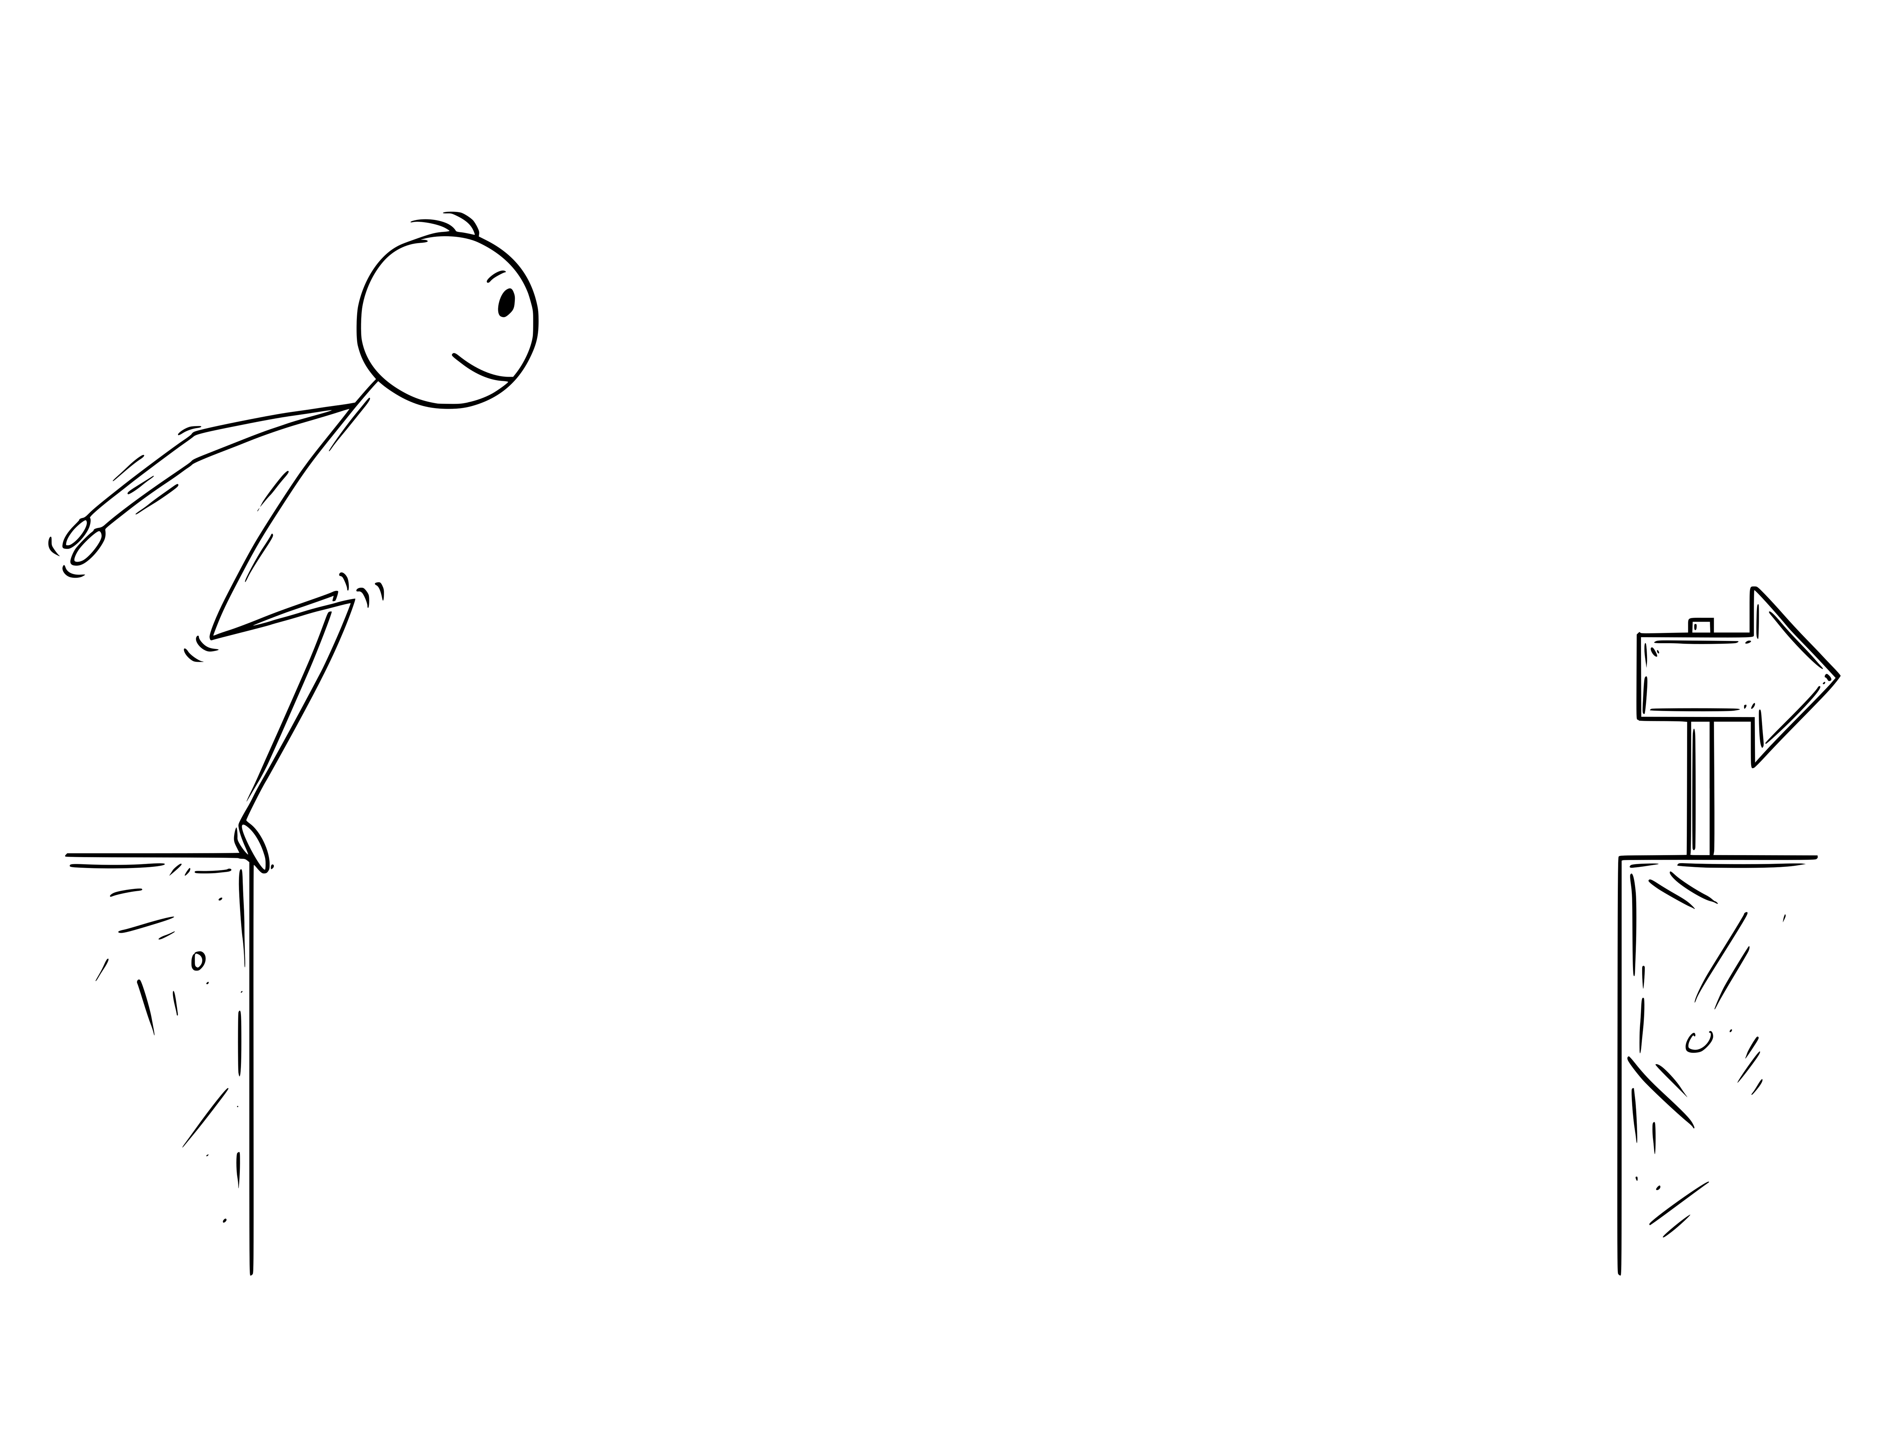
Dev to Leader
One Developer’s Story
Michael Eaton
Principal Consultant @ Improving
Cincy Deliver 2023
Notes:
Welcome the audience.
You've spent years working on your tech skills. You are at the top of you game and can write code with the best of them.
Then, one day, a leadership position opens on your team and you start thinking about it.
Should I?
Shouldn't I?
What if I hate it?
What if I love it?
What if I'm terrible at it?
Switch slides for some foreshadowing

Slide 3
and occasionally back again!
One Leader’s Story
Michael Eaton
Principal Consultant @ Improving
Cincy Deliver 2023

Slide 4
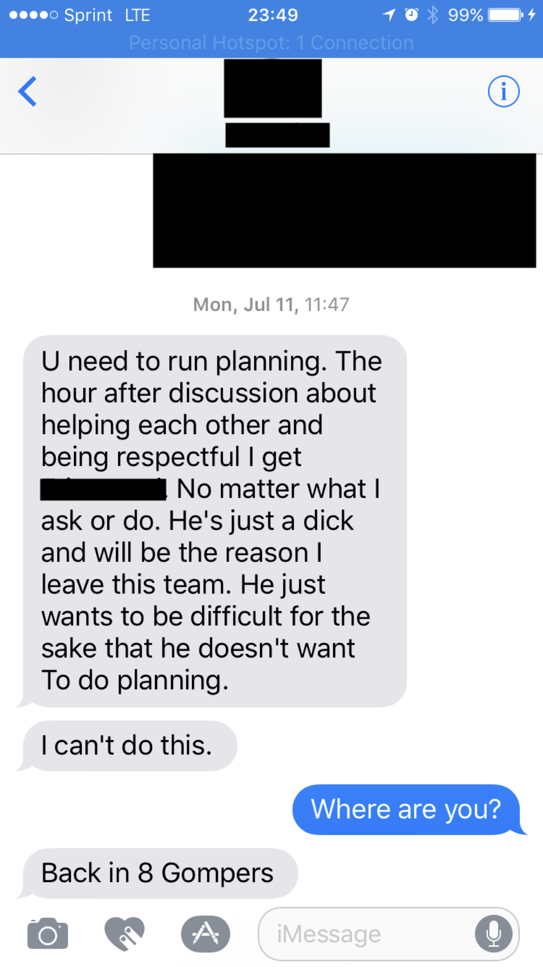
Notes:
It was my first official day as the team leader on the team I had joined just 18 months earlier. The entire team was on-site for planning. I had started the morning with a discussion on trust and respect and how we should be supporting each other. We started planning and things were going well when I stepped out to join my leader’s staff meeting. I left our BA in charge of running the meeting. Within 15 minutes, I was receiving text messages from my team.
The first text read
“U need to run planning. The hour after discussion about helping each other and being respectful I get <redacted>. No matter what I ask or do. He just a dick and will be the reason I leave this team. He just wants to be difficult for the sake that he doesn’t want to do planning.
I can’t do this.” <click to show image>
I showed my leader my phone and we quickly adjourned his meeting so I could get back to my team and figure out what was going on. The text messages continued as I made my way over to where I had left them just 20 minutes earlier. What happened over the next day or two had a huge impact on me as a leader and taught me lessons I haven’t forgotten.
Welcome to leadership, and welcome to my journey.
But first, a bit about me…

Slide 5

Married for 26 years
Father to 2 adult children
Slave to three cats
Developer with almost 30 years of professional experience
Writer / Blogger
Principal Consultant at Improving

Slide 6

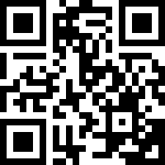
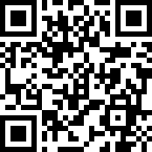
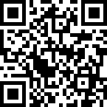
Improving is a modern digital services company that offers IT consulting, software development, and agile training across the globe. Our innovative solutions have helped thousands of our clients realize their tactical and strategic business objectives, allowing them to achieve great new heights in a competitive and ever-changing market.
Improving’s website https://improving.com
Improving Careers and Open Positions https://improving.com/careers
Improving Training and Upcoming Classes https://improving.com/services/training/

Slide 7
Tell
you about my journey in moving from an individual contributor role to a people leader (and back again a couple times)
Talk about
my reasons for becoming a leader and for moving between the roles over time
Give
you an idea of the challenges I’ve experienced and how I’ve overcome some of them
Notes:
When I started giving this talk back in 2017, it had been less than a year since that day. I thought I had things figured out, but since then, I have continued to learn
and grow as a leader. I have stepped between being an individual contributor and leader several times over the last few years.
During the next (n minutes), I want to
Tell you about my journey
Talk about my reasons for becoming a leader and for moving between the roles over time
Give you an idea of the challenges I’ve experienced and how I’ve overcome some of them

Slide 8
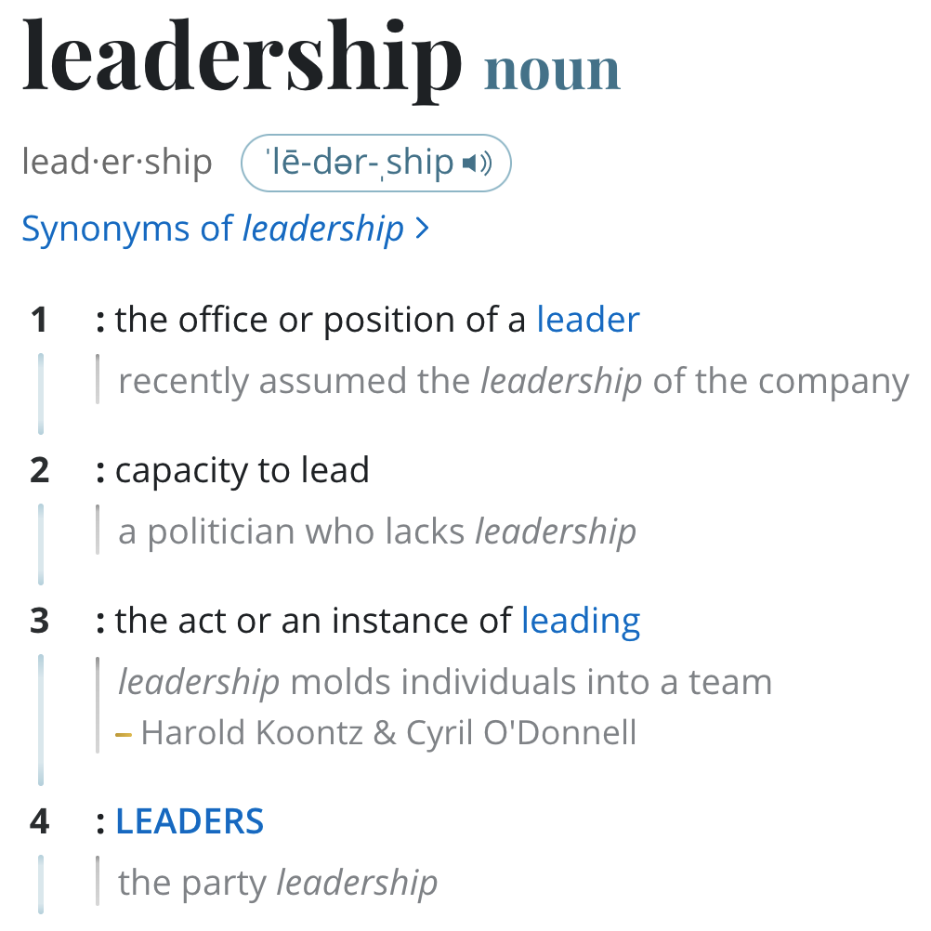
Notes:
Before I dive into my path, let’s define what leadership is…
The Merriam-Webster dictionary defines leadership as “the act or an instance of leading”
mmmhhhmmm

Slide 9
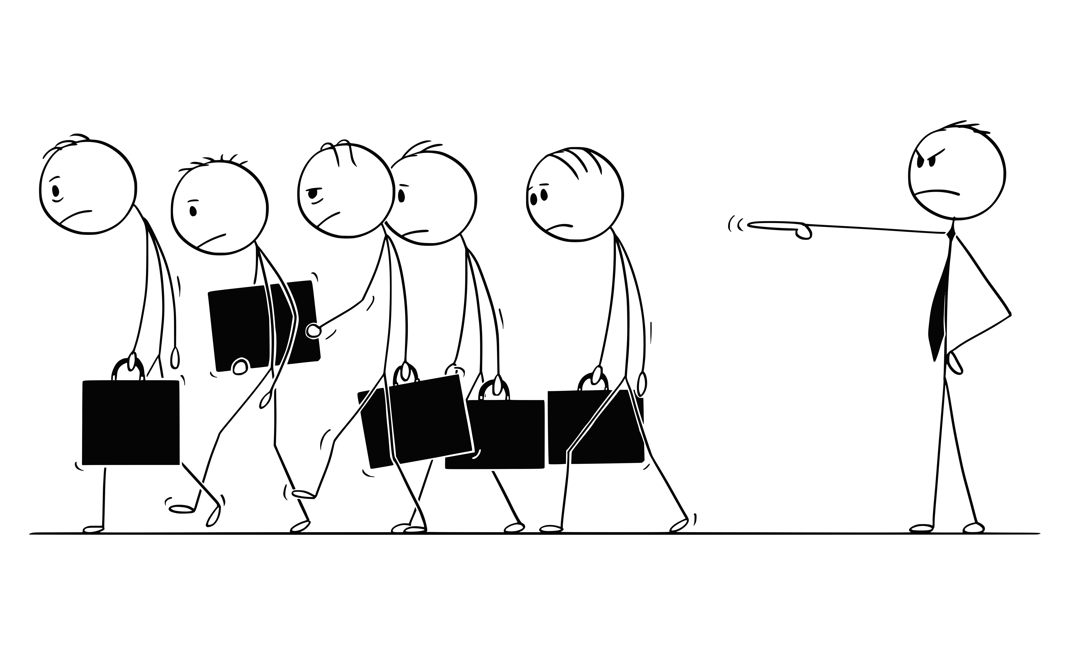
Notes:
How many have worked for leaders like this?
This is what I’d call a traditional leader and I struggle to use the word leader. This is a manager. This is typically not someone who builds solid relationships with their team.
Story about Igor… (I want to be a leader so I can tell people what to do and how to do it)

Slide 10

(Servant) Leadership
Notes:
By comparison, the servant-leader shares power, puts the needs of others first and helps people develop and perform as highly as possible.
In his book, Trust Based Leadership, Mike Ettore, a retired Marine Corp officer says that “leadership, in its purest and noblest form, is always associated with an individual choosing to be responsible for the successful accomplishment of an organization’s mission and the welfare of its people and their personal and professional aspirations.
He goes on to say
There’s a huge difference between being in a leadership role and actually being a leader.

Slide 11
2000
Tech Lead / Project Director
2007
Consultant /
Tech Lead
2016–2018
Team Leader
2018–2019
Director of Engineering
2019–2020
Back to being an IC
2020–2021
Principal Analyst leading offshore team
2022-current
Current - Principal Consultant with direct reports
1995-2000
Just a developer
2021
Principal -> Dev Manager
2014-2015
Senior Developer
Notes:
Here is my career in a Powerpoint timeline. Looks pretty boring from this view,
A couple things to point out here – from 2001 until 2014, I was an independent consultant. I worked directly my clients, most times as a solo developer. There were times I stepped into teams, as you can see from 2007. I actually wrote 6 blog posts about that project and all the mistakes I made, especially as a leader. The old blog is dead, but I hope to republish it in the near future.
The point here is that my real leadership journey started in 2014 when I started at Big FinTech.

Slide 12
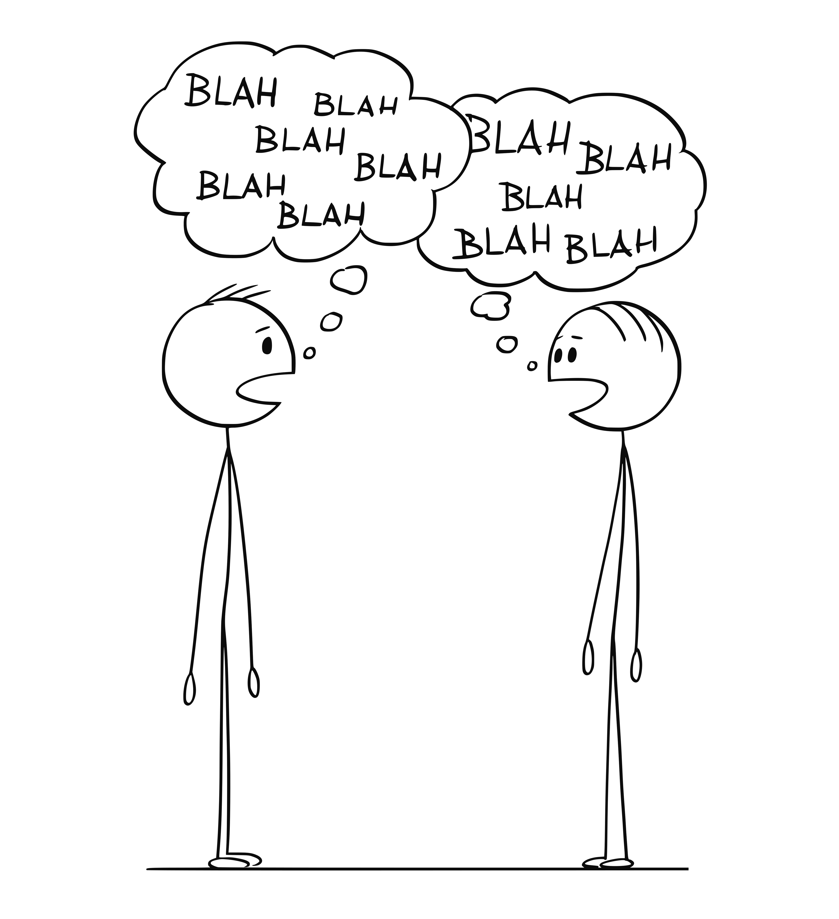
Notes:
Shortly after I started, my leader started talking to me about leadership. A good leader is always looking for their replacement, and he knew that eventually
he'd move on to a different role and thought I would make a good leader for the team.
At first, I didn't really take the conversations seriously. The fact is, I was enjoying what I was doing. I went into the job saying
"I'll give it a year and then see if I want to stay, or maybe go back to being an indie."

Slide 13

NO!
Notes:
I initially said, "no", mainly because I simply needed to make it to that 1-year
milestone.

Slide 14

The first step in calculating which way to go is to find out where you are.
- Margaret Thatcher
Notes:
At my 1-year anniversary, I knew I was going to stick around. It was a great company. The team worked hard and played hard.

Slide 15
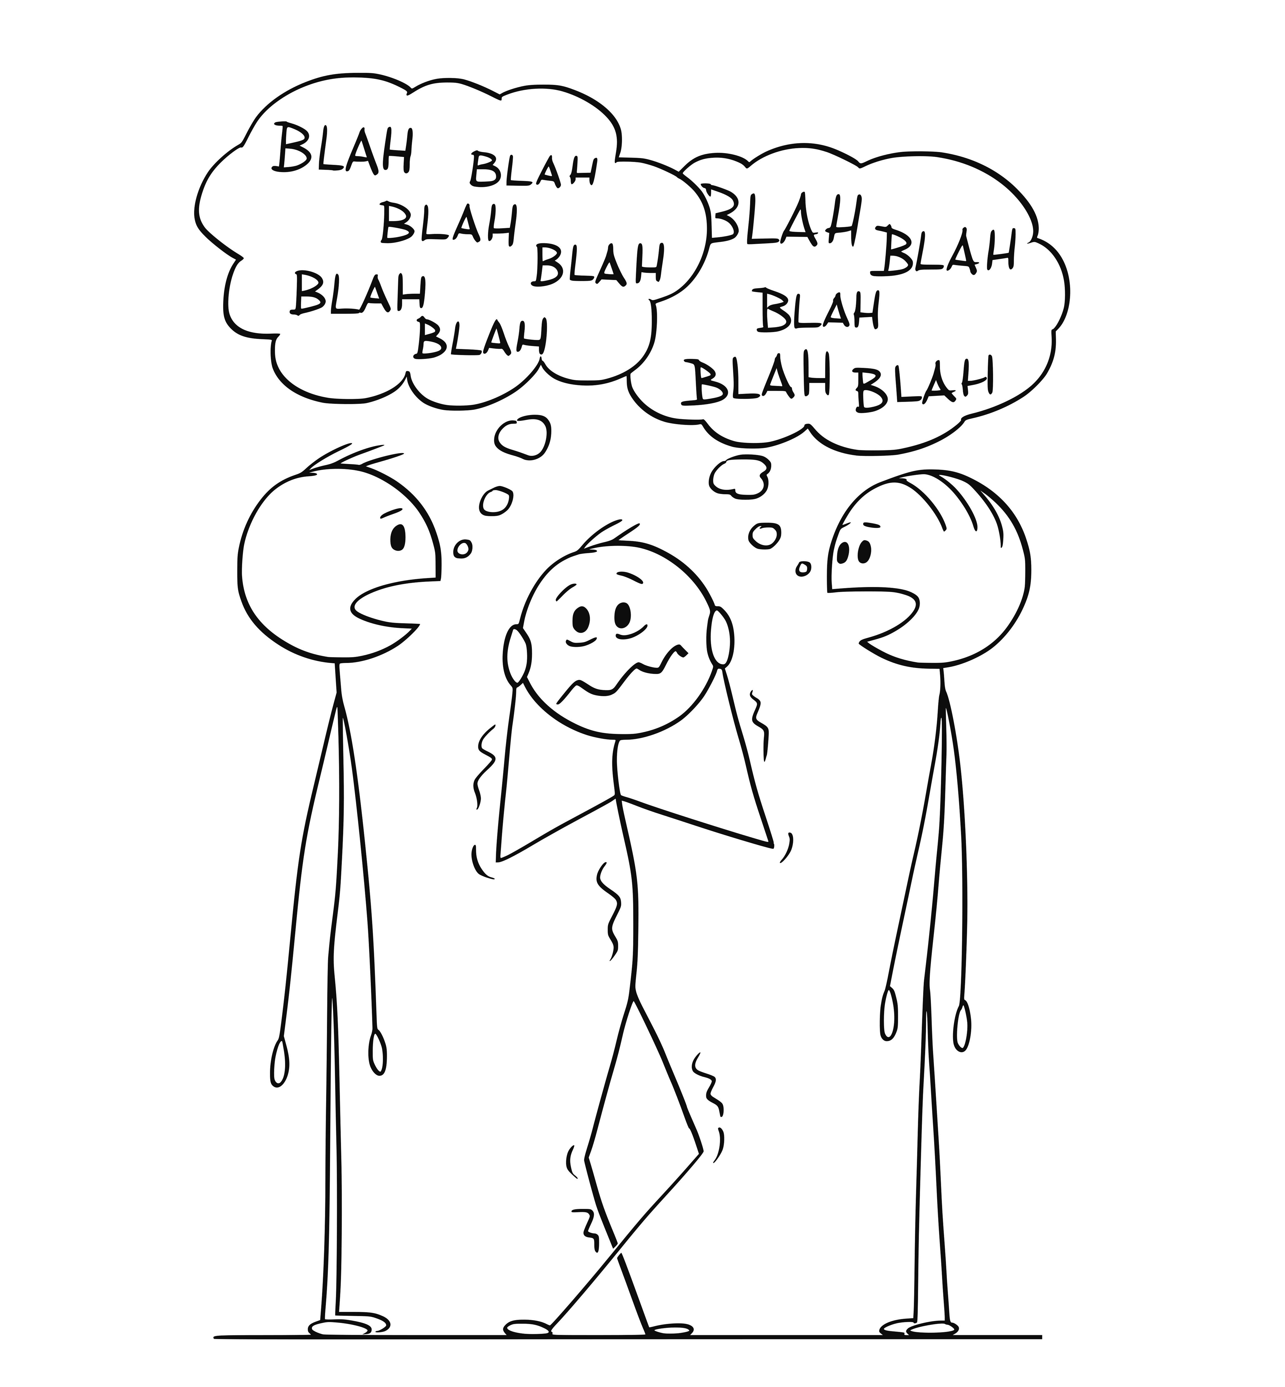
Notes:
Right around the time of my 1-year anniversary, I was out having drinks with my leader
and a friend. At some point during the conversation, my friend looked at my leader (they
were friends as well) and asked point blank, "so, when is mike gonna be a leader?"
My leader looked at me and said, "it's up to him".

Slide 16
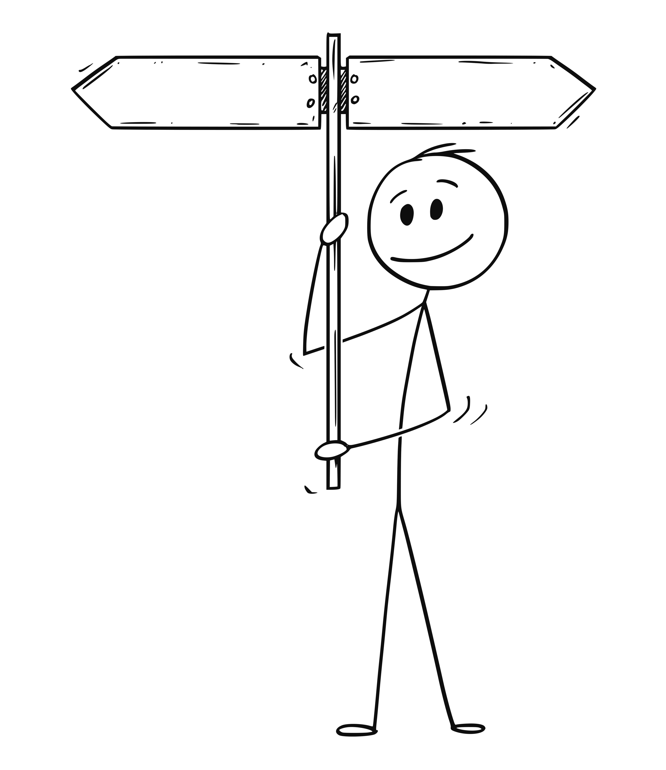
Developer
Leader
Notes:
I started to seriously consider it, but it still wasn’t a simple choice. I needed a Why.

Slide 17
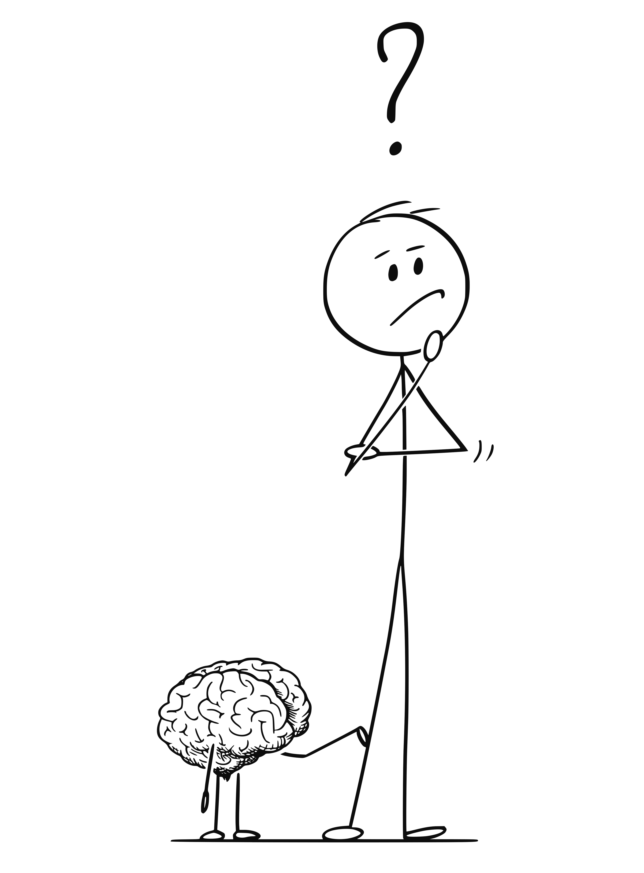
Notes:
The Why is important. Just because he asked wasn’t enough. Just because he thought I would do a good job wasn’t enough. I needed more.
I spent a lot of time thinking about it.
I made pro/con lists. I talked to other leaders. I talked to friends and family.

Slide 18
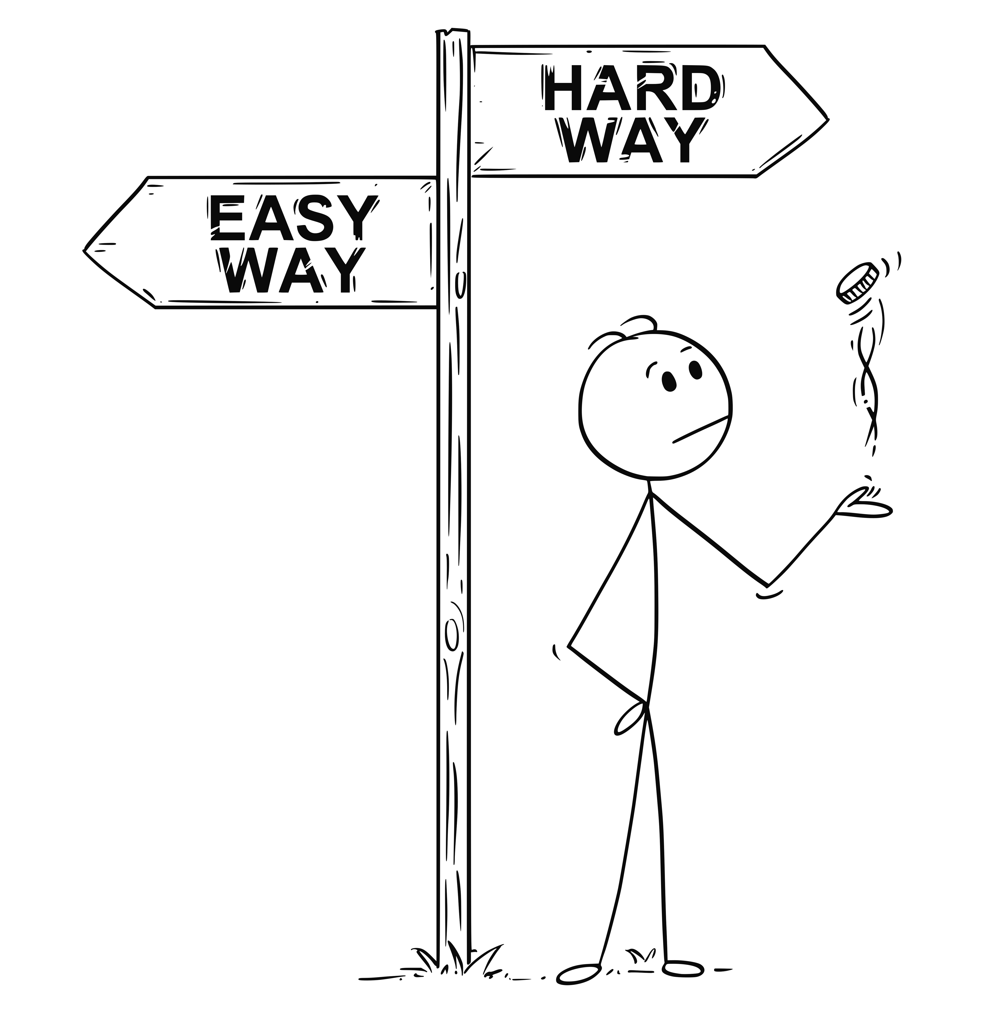
Notes:
I knew taking the role wasn’t going to be easy. There were risks involved.

Slide 19
Do all the good you can, for all the people you can, in all the ways you can, as long as you can.
- Hillary Clinton
Notes:
At some point, it hit me - I could do more for the team as their leader as I could a peer.
“Do all the good you can, for all the people you can, in all the ways you can, as long as you can.”
I had my Why, Why Not?

Slide 20

Notes:
I also had a lot of Fear
What if I took the role and hated it. What if I took it and I sucked? What if I took it and my team hated me? What if I took the role and I hated me?

Slide 21
Research suggests that we tend to regret what we haven’t done much more than what we have done – even if we screwed up in doing it.
- Ben Hunt-Davis
Notes:
Research suggests that we tend to regret what we haven’t done much more than what we have done – even if we screwed up in doing it.
I eventually interviewed for the role and surprisingly turned out to be the best candidate.
In June 2016, I officially became the leader of the team I had started on 18 months earlier.

Slide 22
2000
Tech Lead / Project Director
2007
Consultant /
Tech Lead
2016–2018
Team Leader
2018–2019
Director of Engineering
2019–2020
Back to being an IC
2020–2021
Principal Analyst leading offshore team
2022-current
Current - Principal Consultant with direct reports
1995-2000
Just a developer
2021
Principal -> Dev Manager
2014-2015
Senior Developer

Slide 23
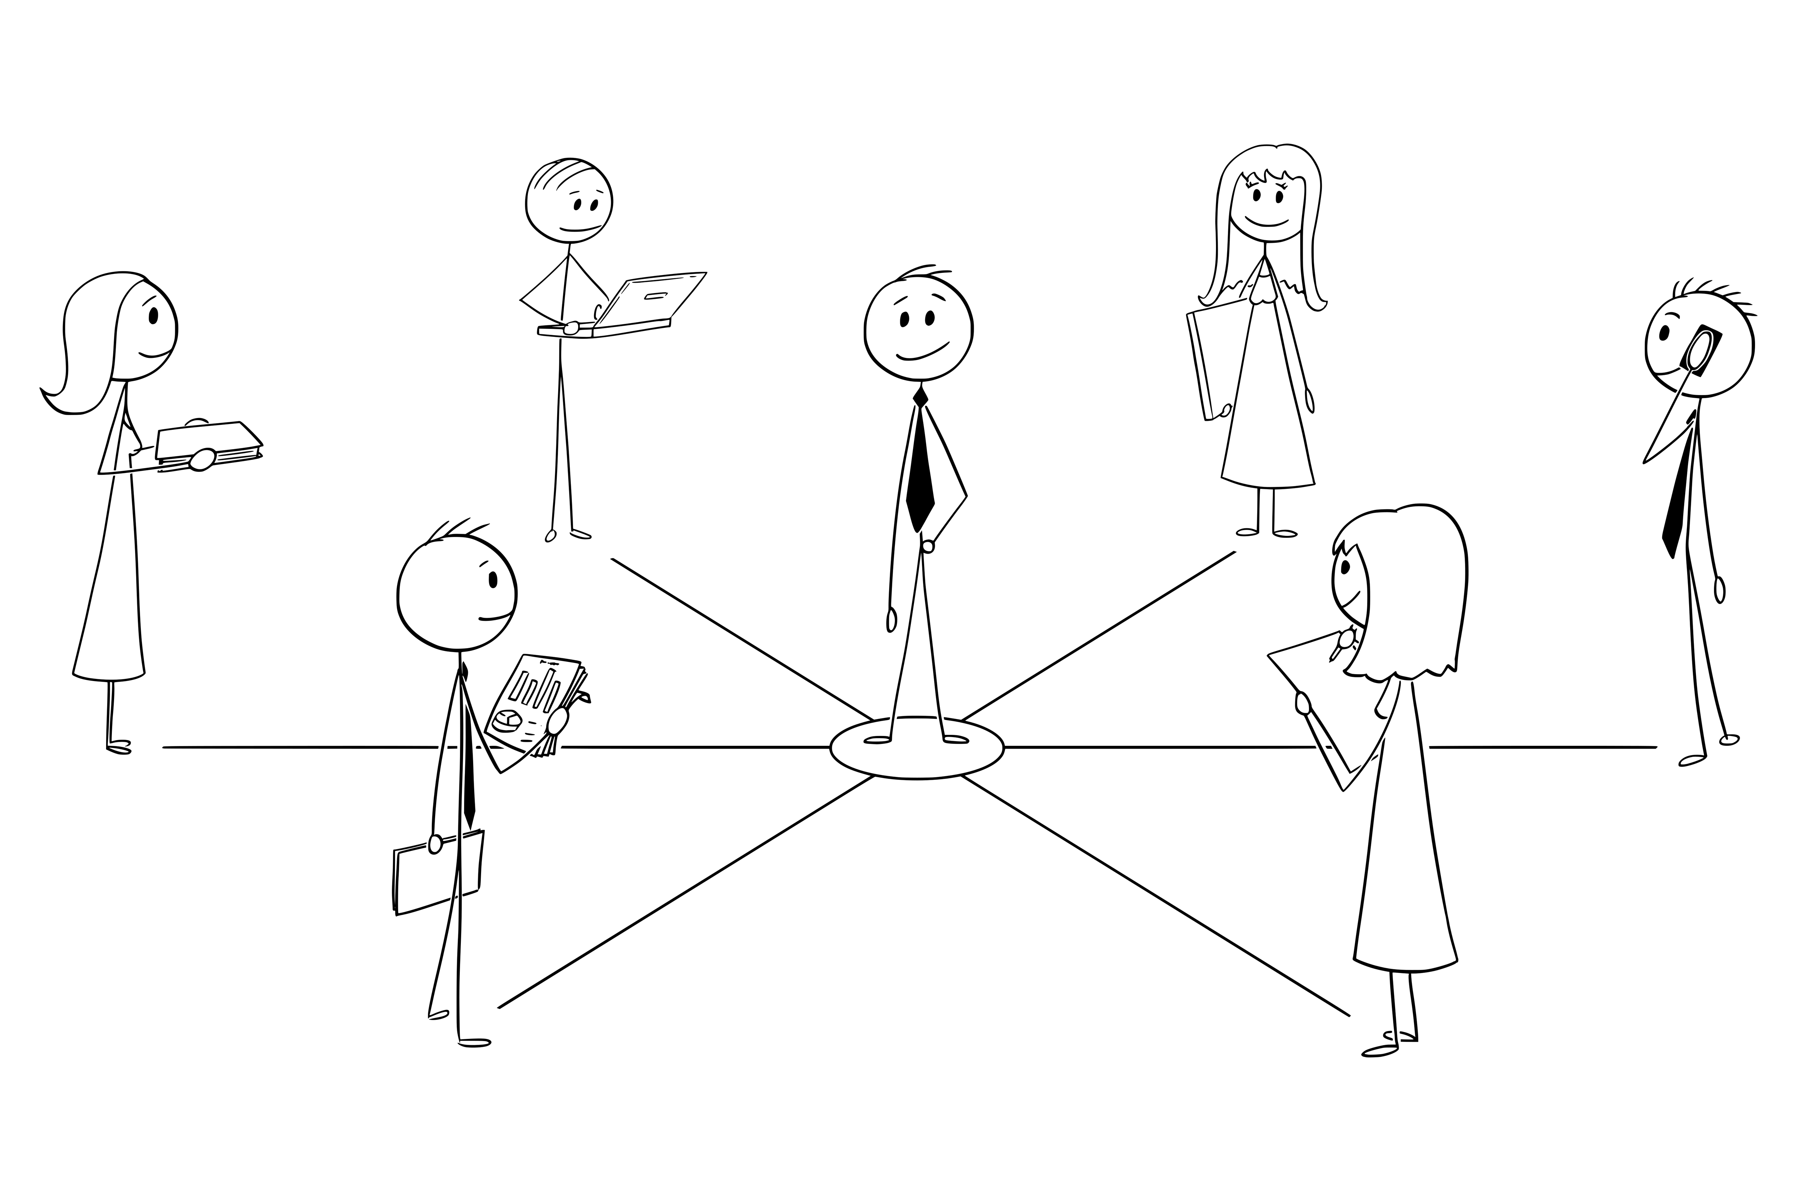
Notes:
The team seemed happy that I was stepping into the role and I was genuinely happy to be given
the opportunity.
Unfortunately, it wasn’t all sunshine and roses, and it certainly wasn’t rainbows and unicorns.

Slide 24
Challenges
Notes:
The team I was leading consisted of 6-7 senior developers, a senior BA and an intern. There was a
fair amount of dysfunction on the team, mainly brought on by the previous leader. Many issues had
festered over the months.
In fact, during the previous months, my leader would frequently ask me how I would handle some of the dysfunction. I think he was out of ideas and was looking for new ones.

Slide 25
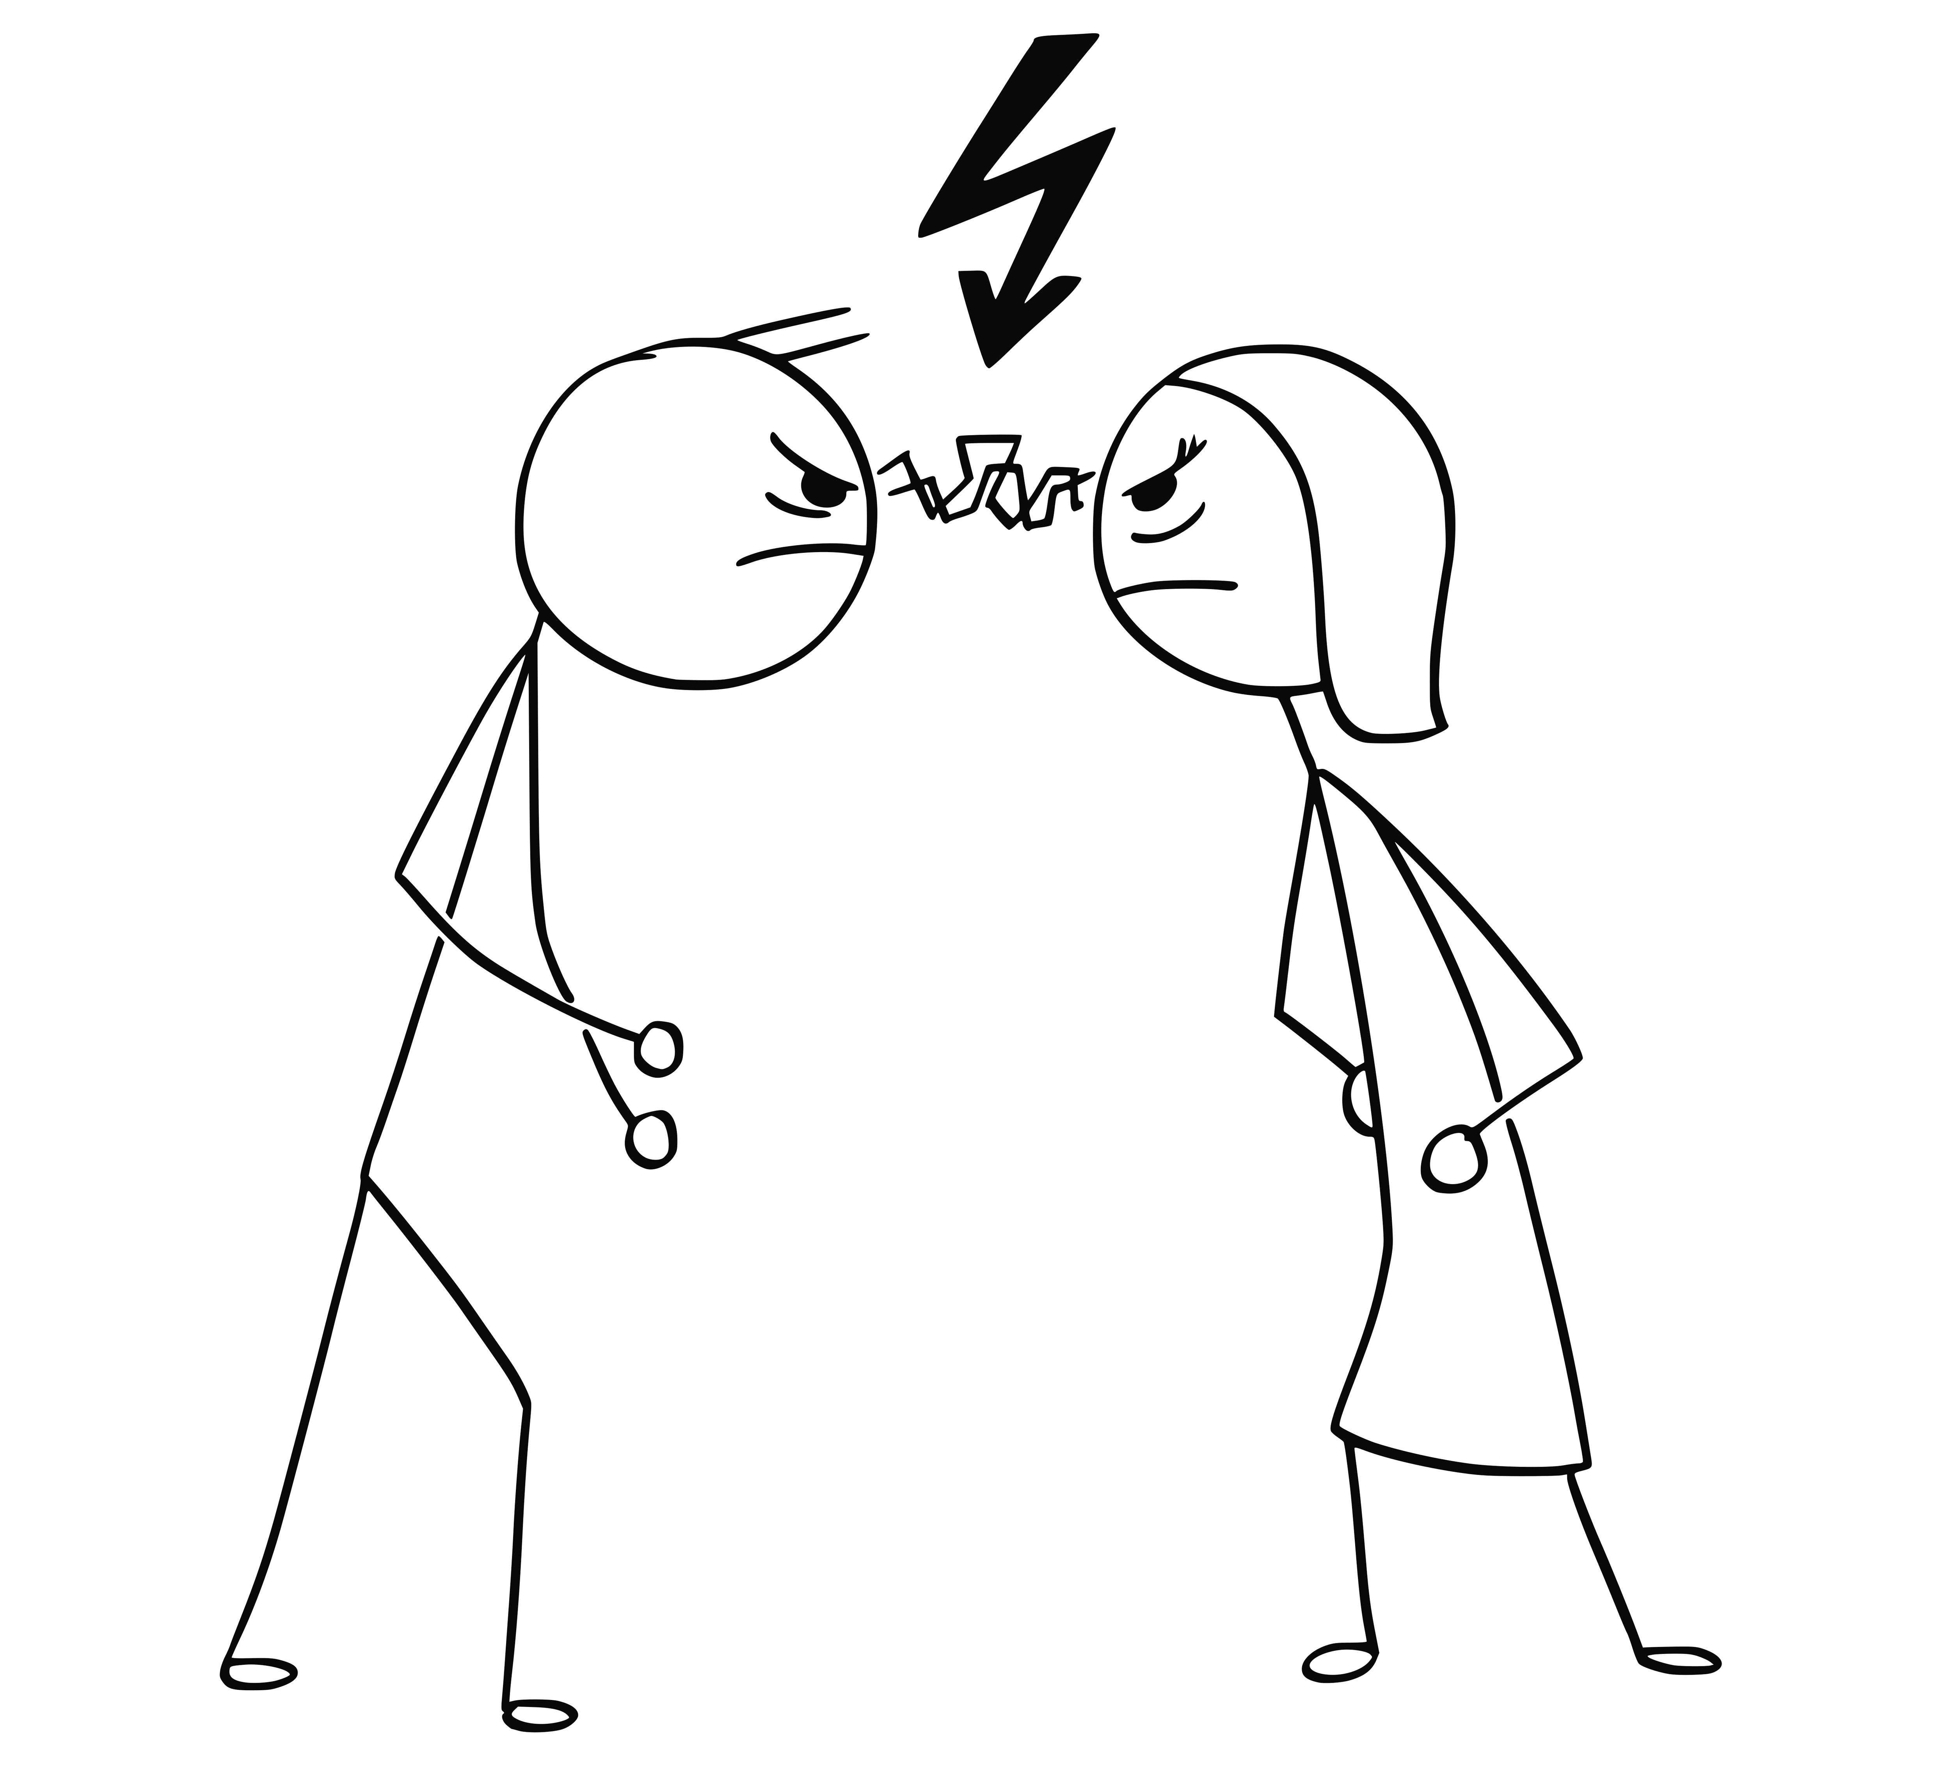
Notes:
Back to that first day!
<explain what happened>
I made mistakes.

Slide 26
People are hard.
- Every Leader Ever.

Slide 27
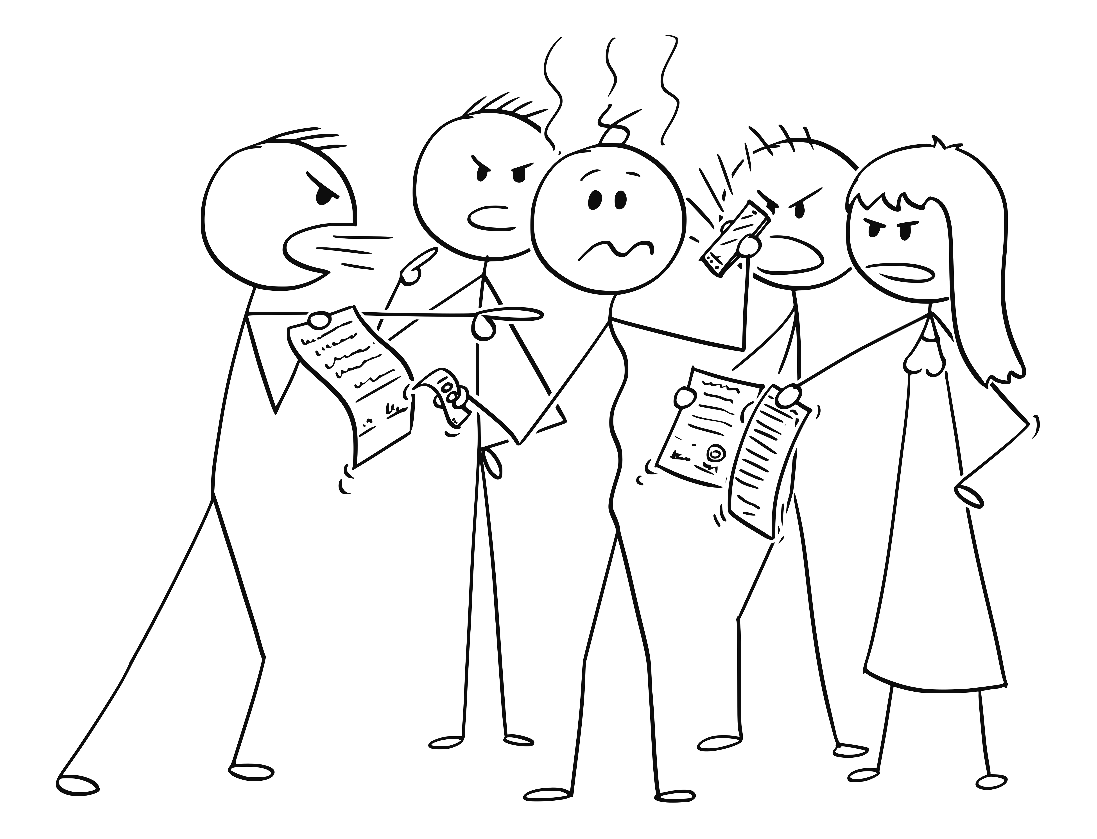
Notes:
You can’t make everyone happy. While my team was generally easy to deal with, there was a definitely forming and storming phase. I had to figure out how to make the transition from coder to leader. I also had to figure out how to figure out how to navigate the “we’re friends, BUT I also know how much you make” issue.
I had to have some difficult conversations.
Talk about being Amanda’s advocate (tie it back to servant leadership)

Slide 28
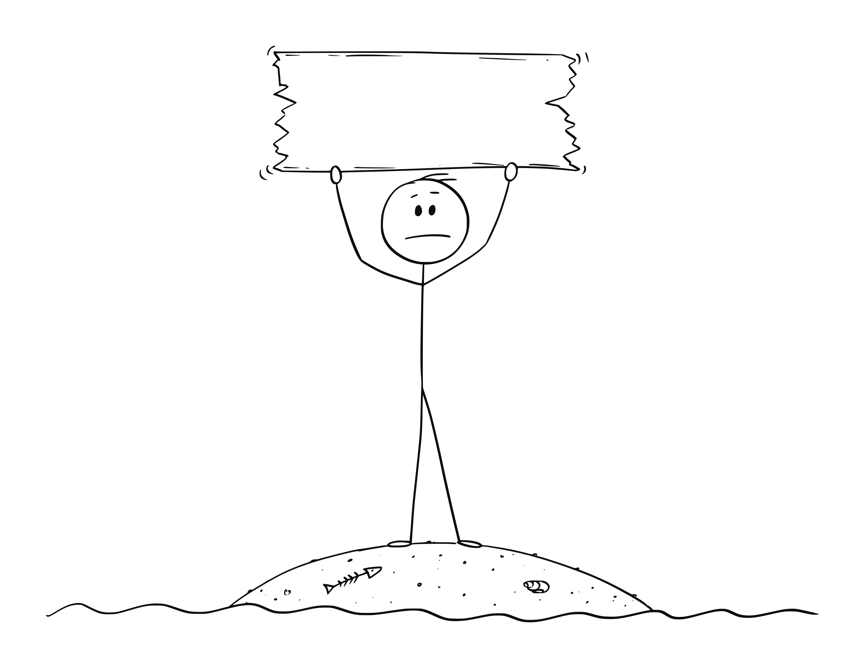
Remote
Leadership
Notes:
Not only was I a leader, I was also remote which brings a whole bunch of other challenges.
Frequent 1:1’s, but on the phone, sometimes with video. Can’t see body language.
Not around for the day-to-day banter.

Slide 29
Good times, bad times

Slide 30
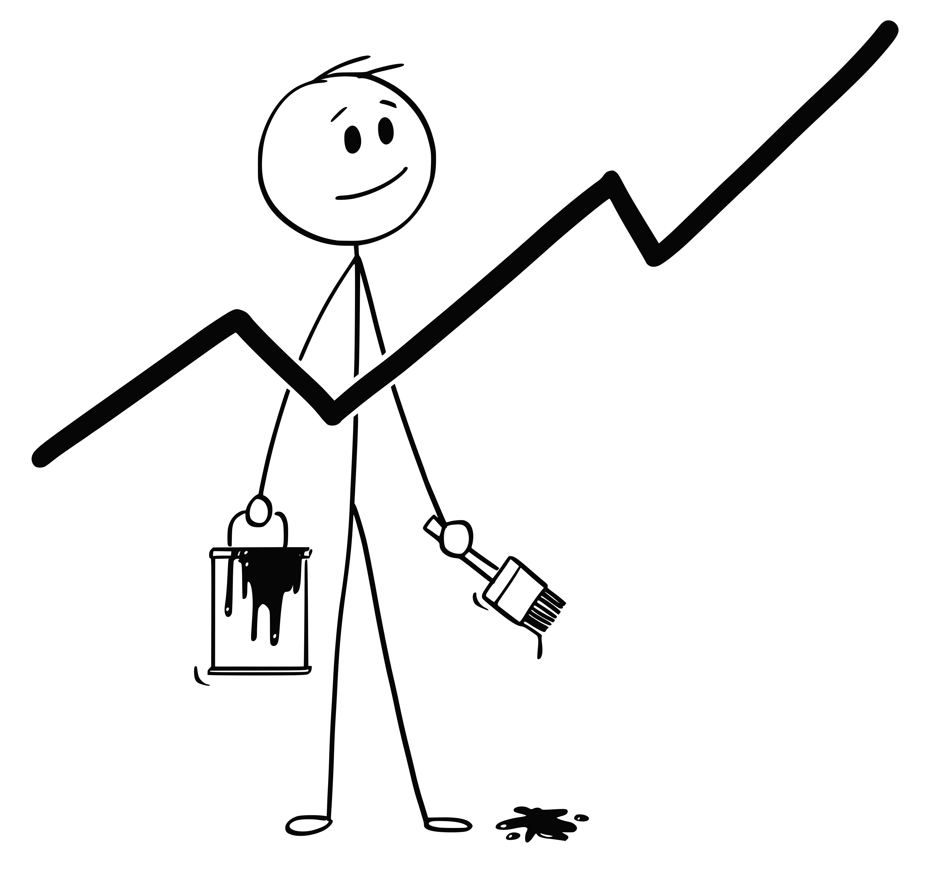
Notes:
The feedback from my team and from my peers was always extremely positive. A survey that was sent to all team members a couple times a year asking about leadership (and the company) was definitely an upward trend.
In one survey, I had 100% team participation (which wasn't necessarily the norm at the company) AND our team relations specialist (think HR) said I had some of the highest scores she'd seen.
Things were good.

Slide 31
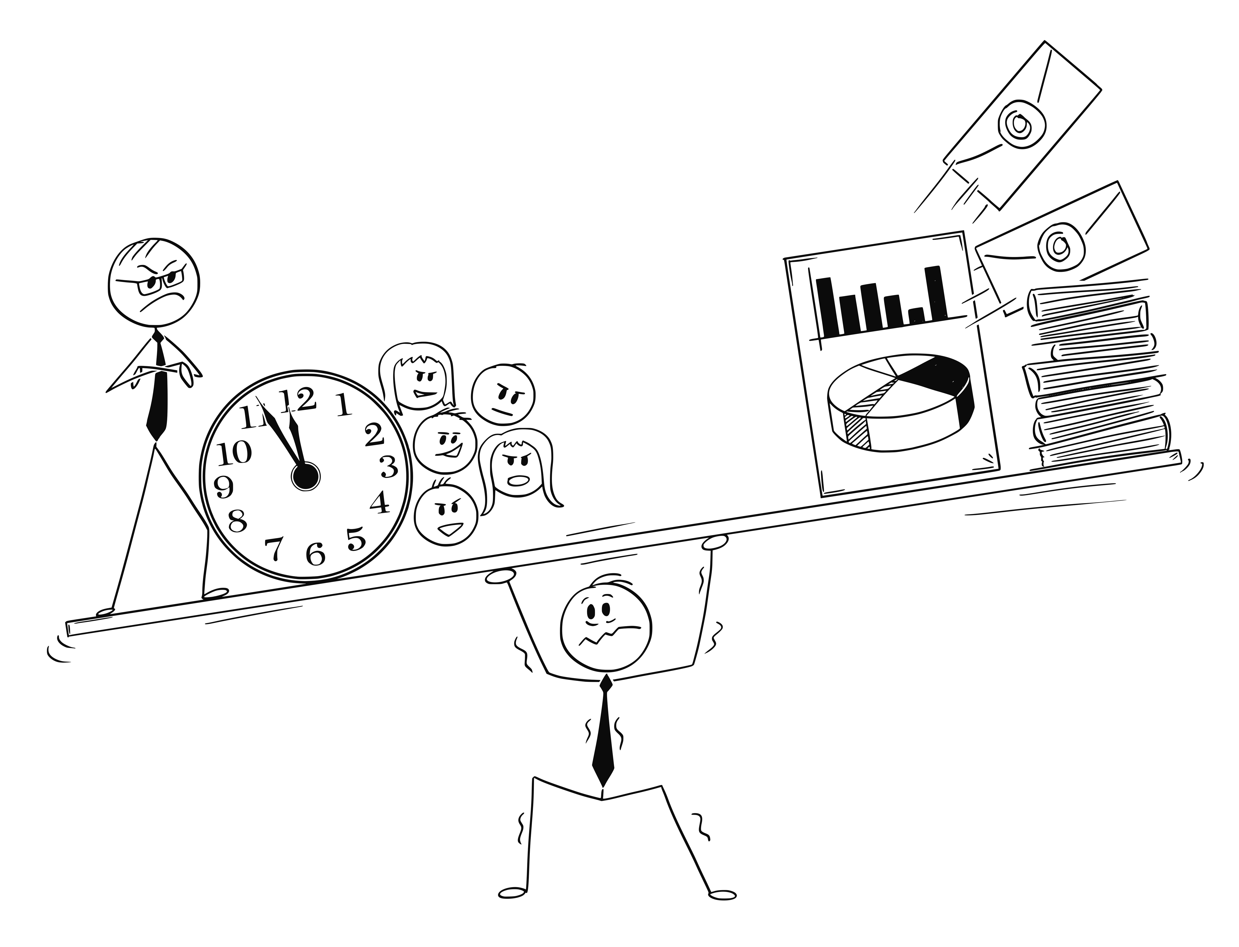
Notes:
I had a lot of things to do – my schedule changed from mostly coding to mostly Outlook and chat and meetings.
Many days were solid meetings, with very little "doing".

Slide 32
Leadership Development
Notes:
I was lucky in that this company invested a LOT of time and money into its leaders. From the start, aspiring leaders had a path. In fact, in the months leading up to my leader interview, I started taking courses on leadership – they were focused on leading myself because if you can’t leader yourself, how can you lead a team.
This particular course focused on a time management, SMART goals, how to write emails, how to leave a good voice mail, etc.
After I became a leader, I was immediately enrolled in an 8-month course where I was randomly grouped with other new leaders. I had never met them before that day. In the first 2 minutes we had to come up with a team name. In the next two minutes, we had to come up with a touchdown dance. Yea, it was as dumb as it sounds. I have no problem at all getting up in front of a group like this, but do NOT ask me to get up in front of a large group and act silly.
Over the course of the 8 months, we had classes on leadership, emotional intelligence, diversity and more. We also had assignments.
There was a competition among all the different teams (6 total teams). In the end, it was a great experience.
One of the other things I did when I took on the new role was to sign up for a leadership coach. (Talk about Martin)

Slide 33
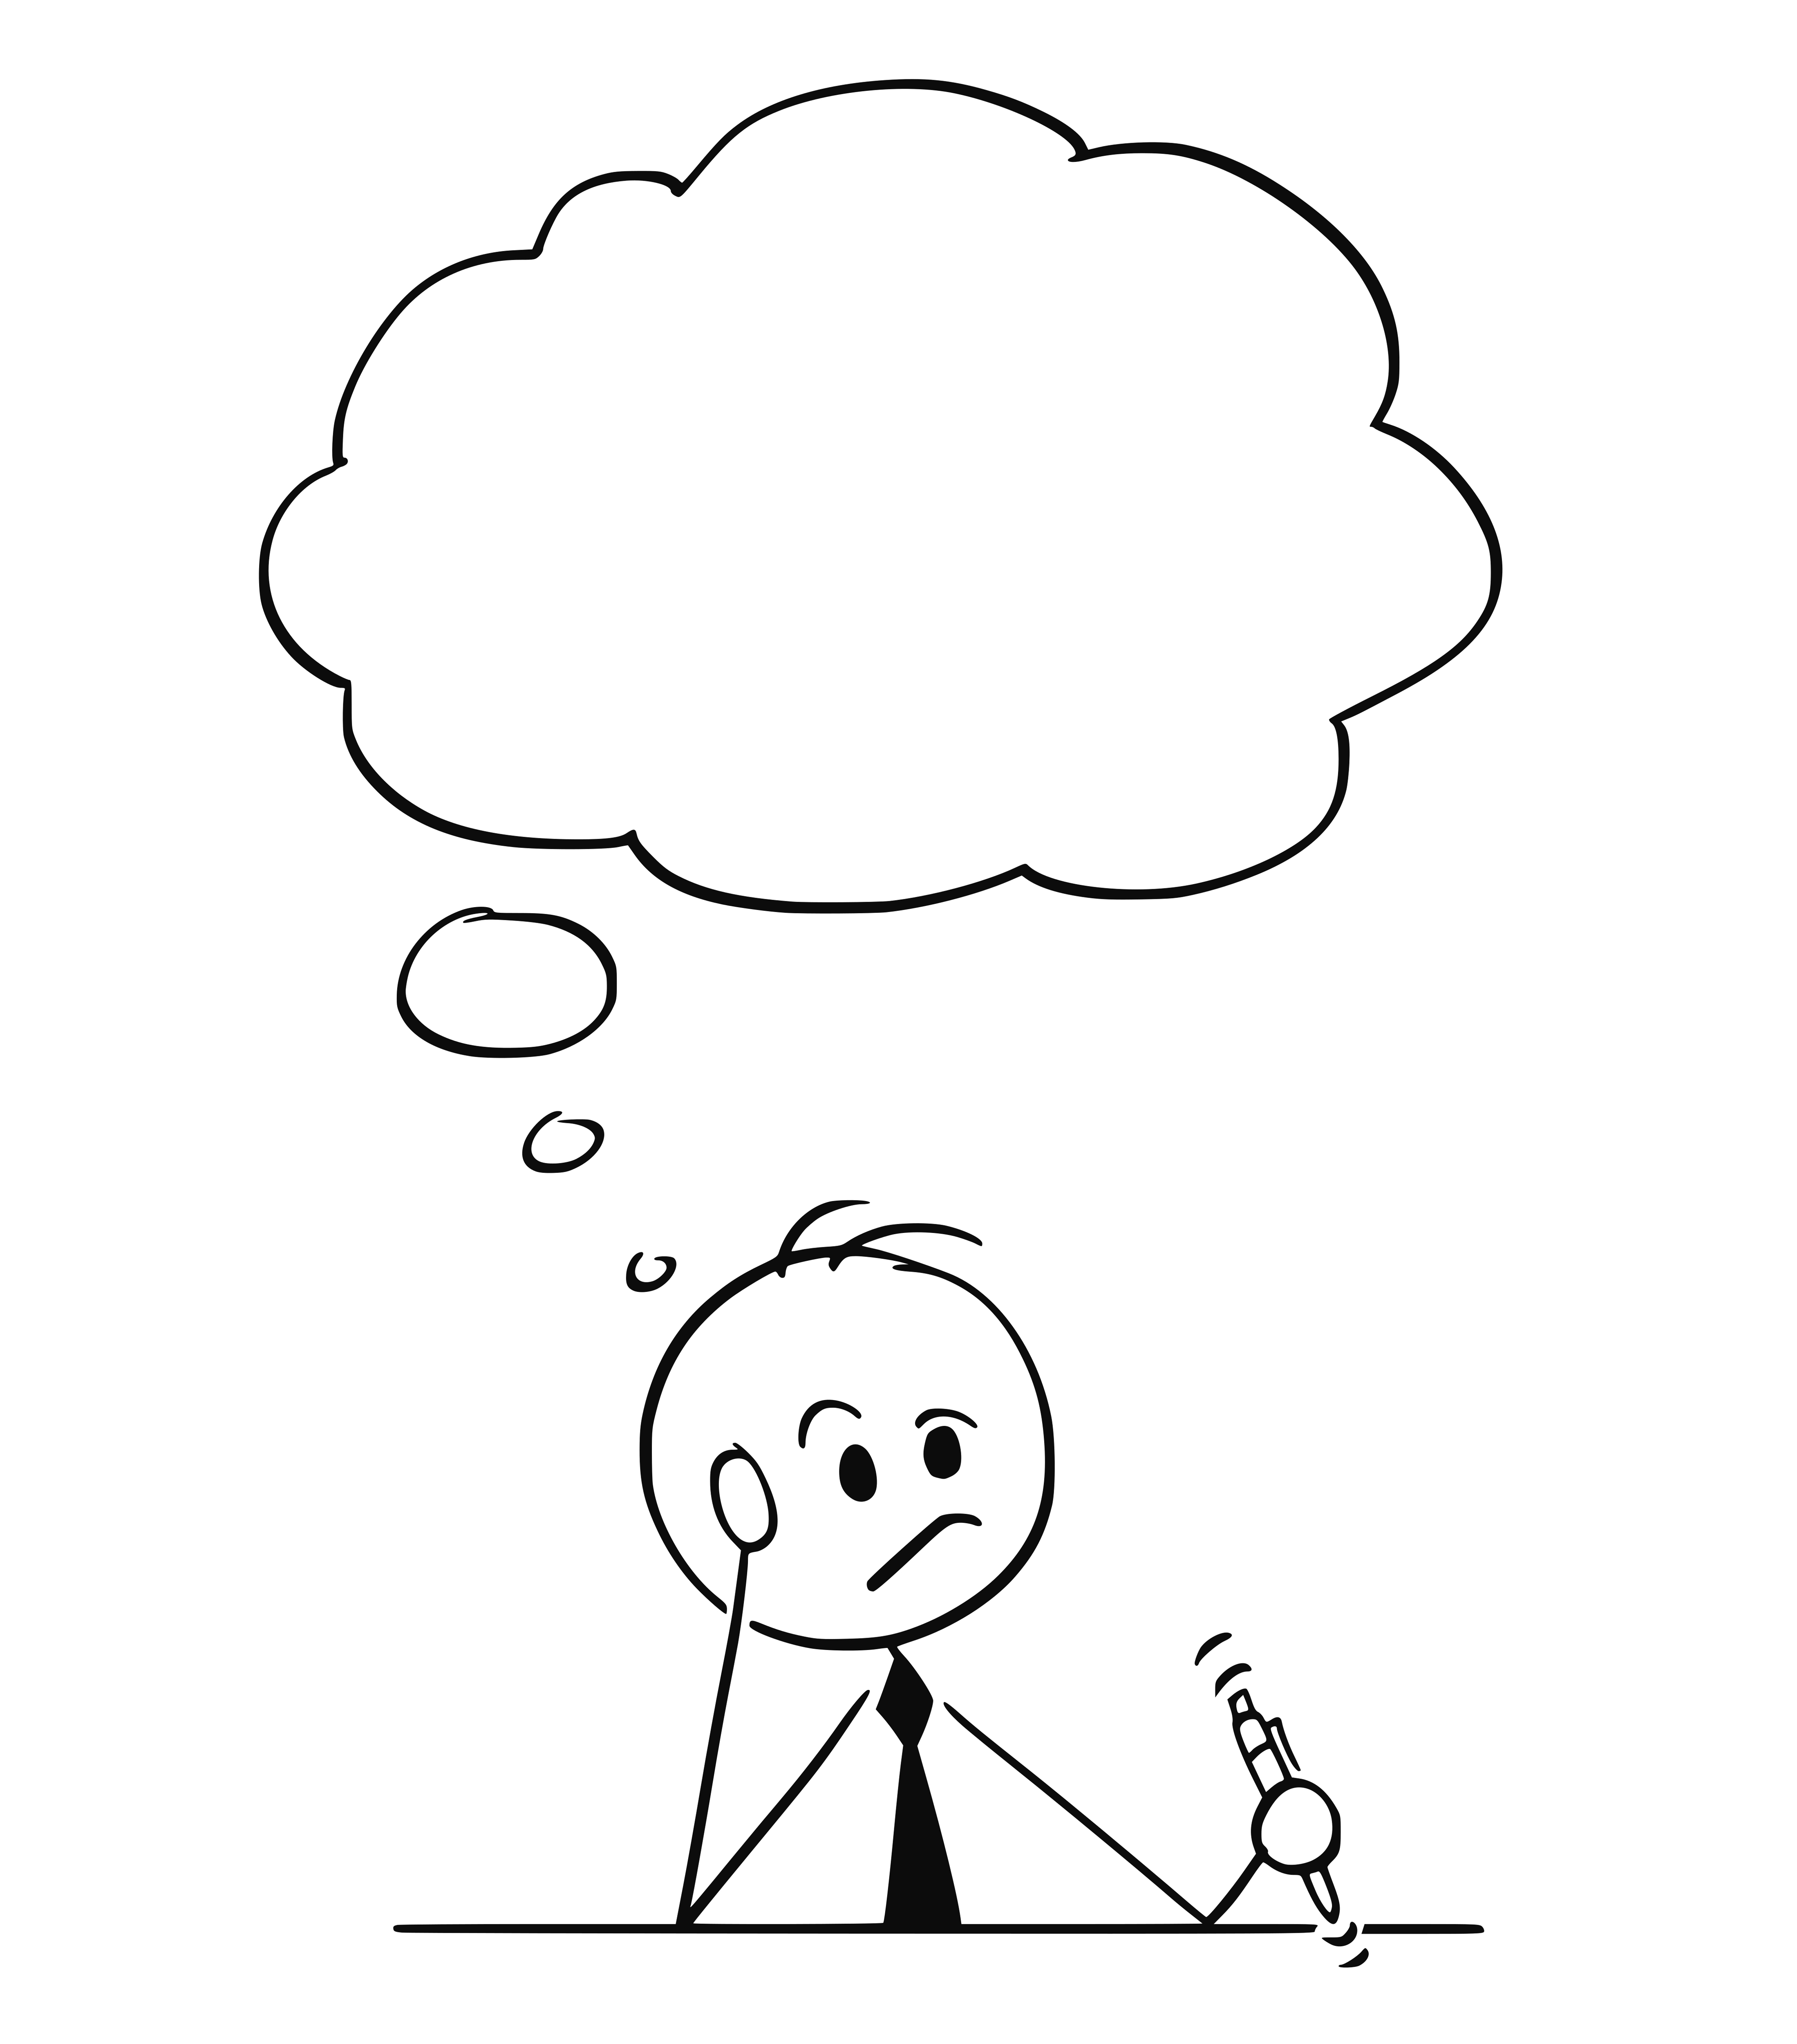
Why did I stop
coding?

Slide 34
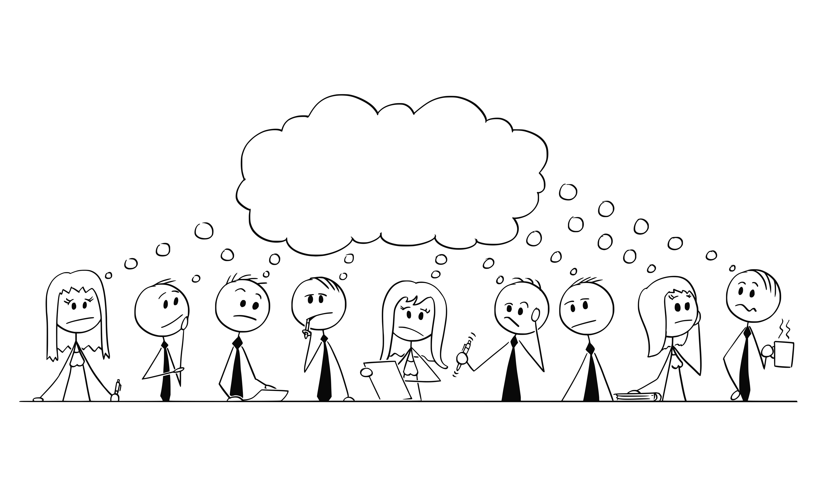

Slide 35
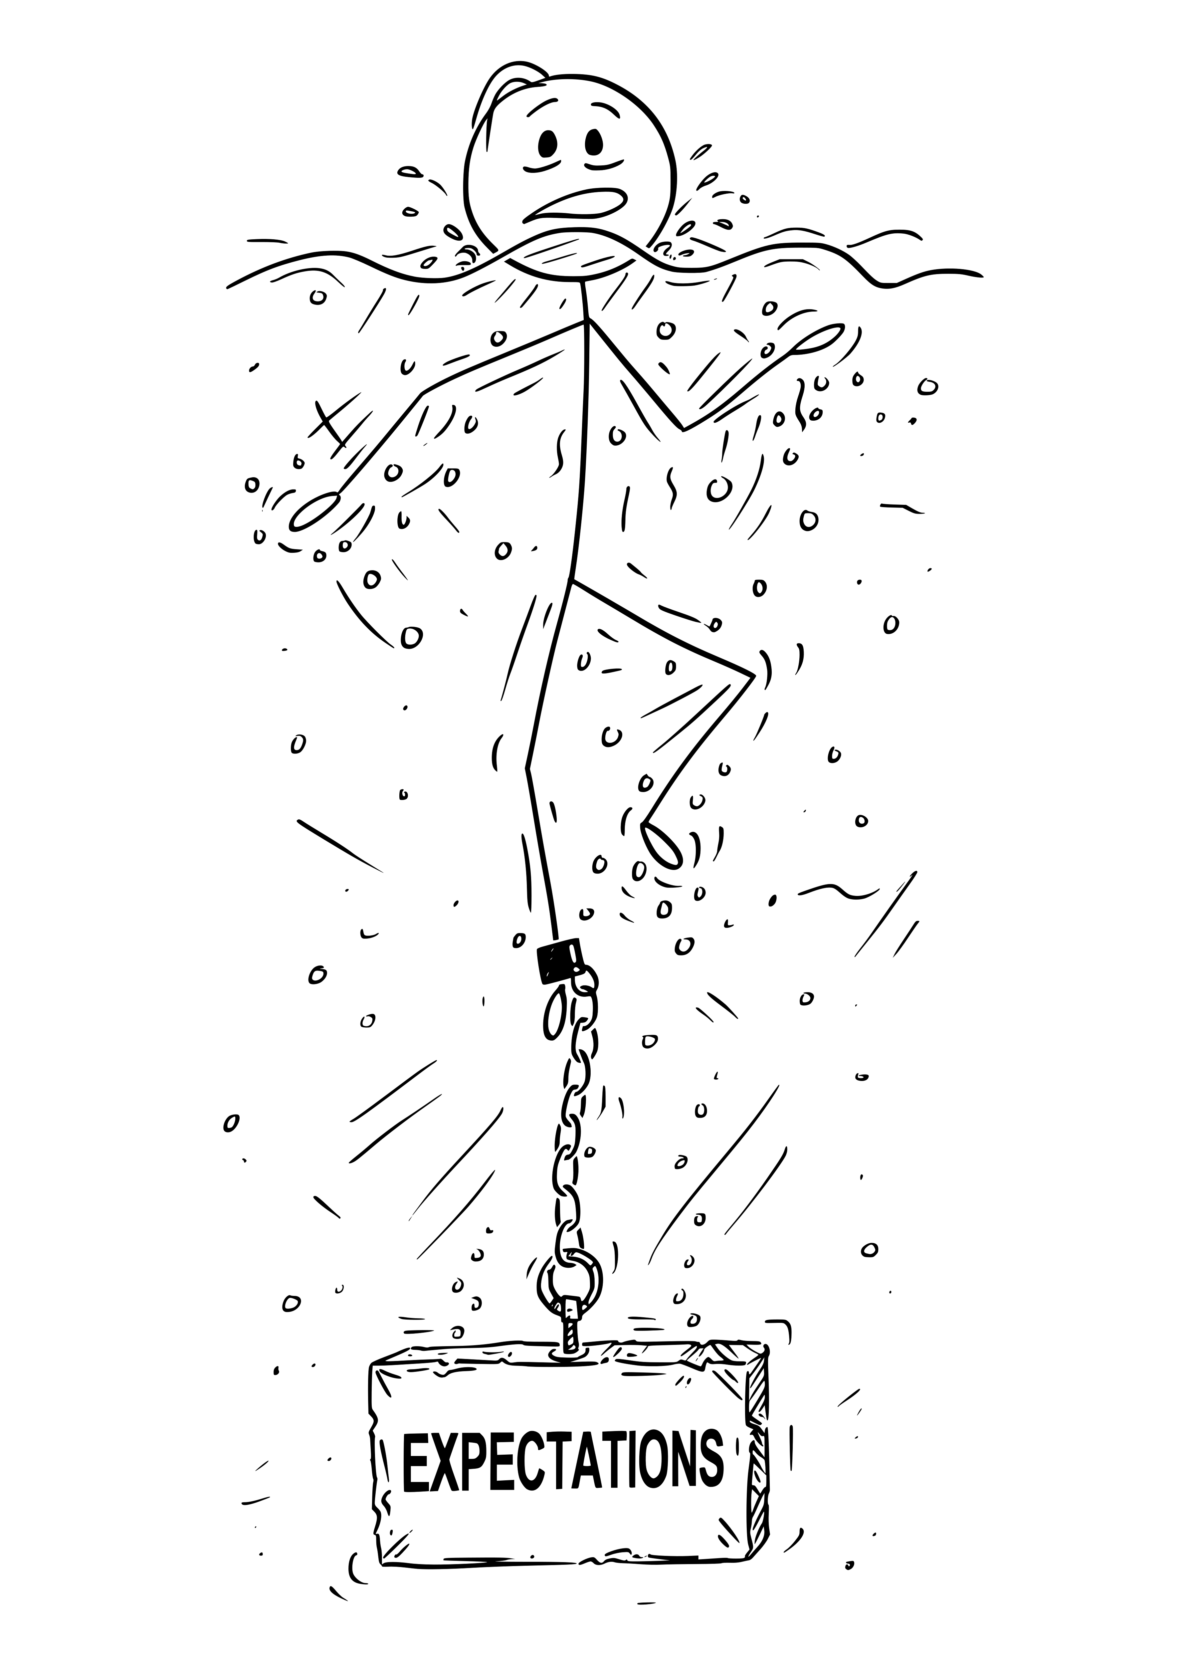
Notes:
Leading my team was never that difficult. Working with my peers was always a good experience.
Leading up was different. I struggled with the expectations that I do more, that I get involved in larger initiatives, that I DRIVE something.

Slide 36
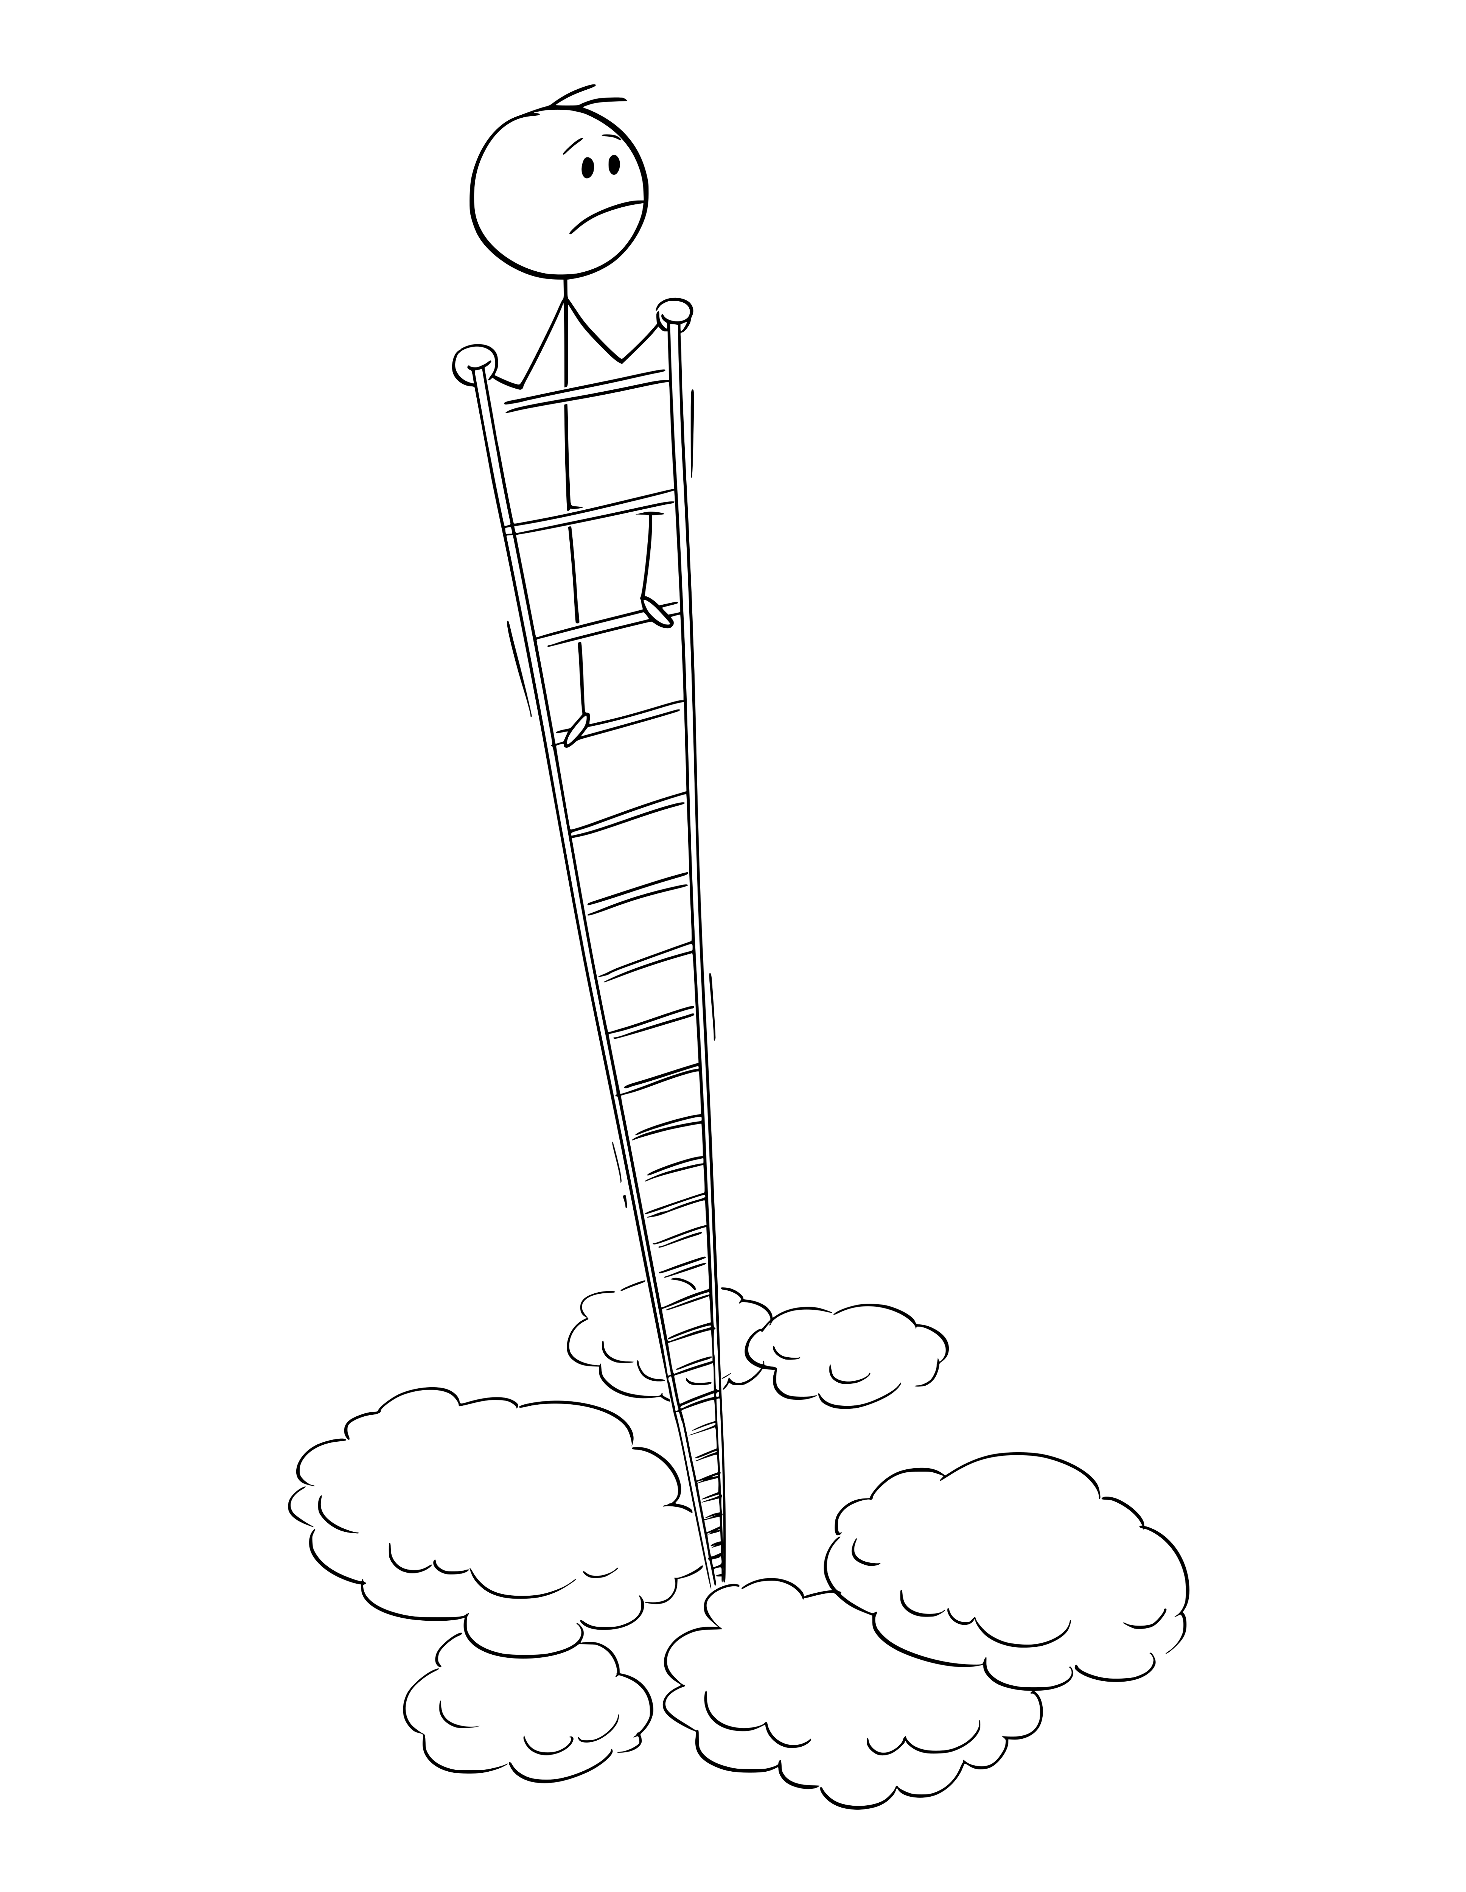
Notes:
I didn’t want to climb any ladders. I just wanted to lead my team.

Slide 37
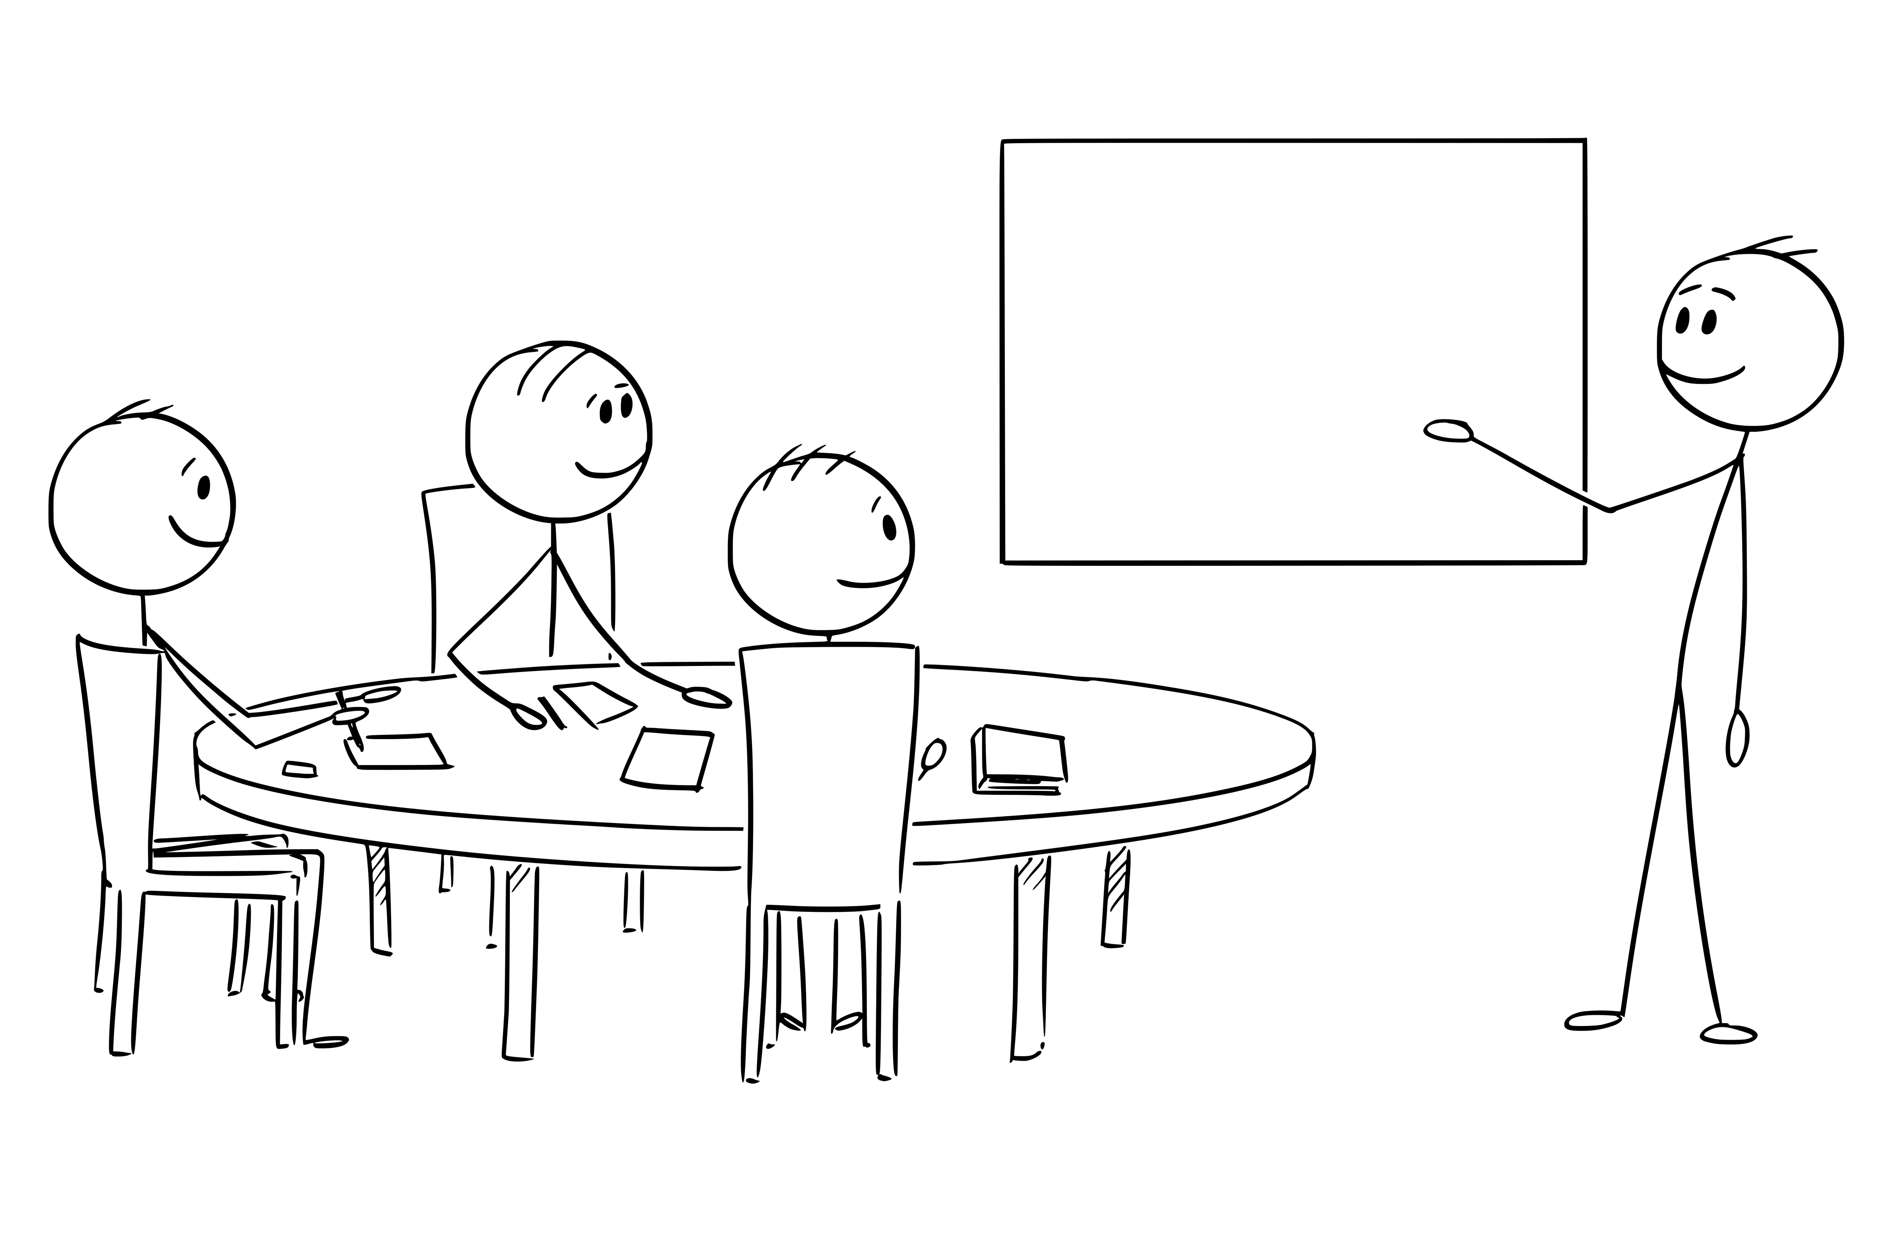
Notes:
Happiness was leading my team. Working with them, helping them grow, NOT all the other stuff.

Slide 38

Notes:
I missed this.

Slide 39
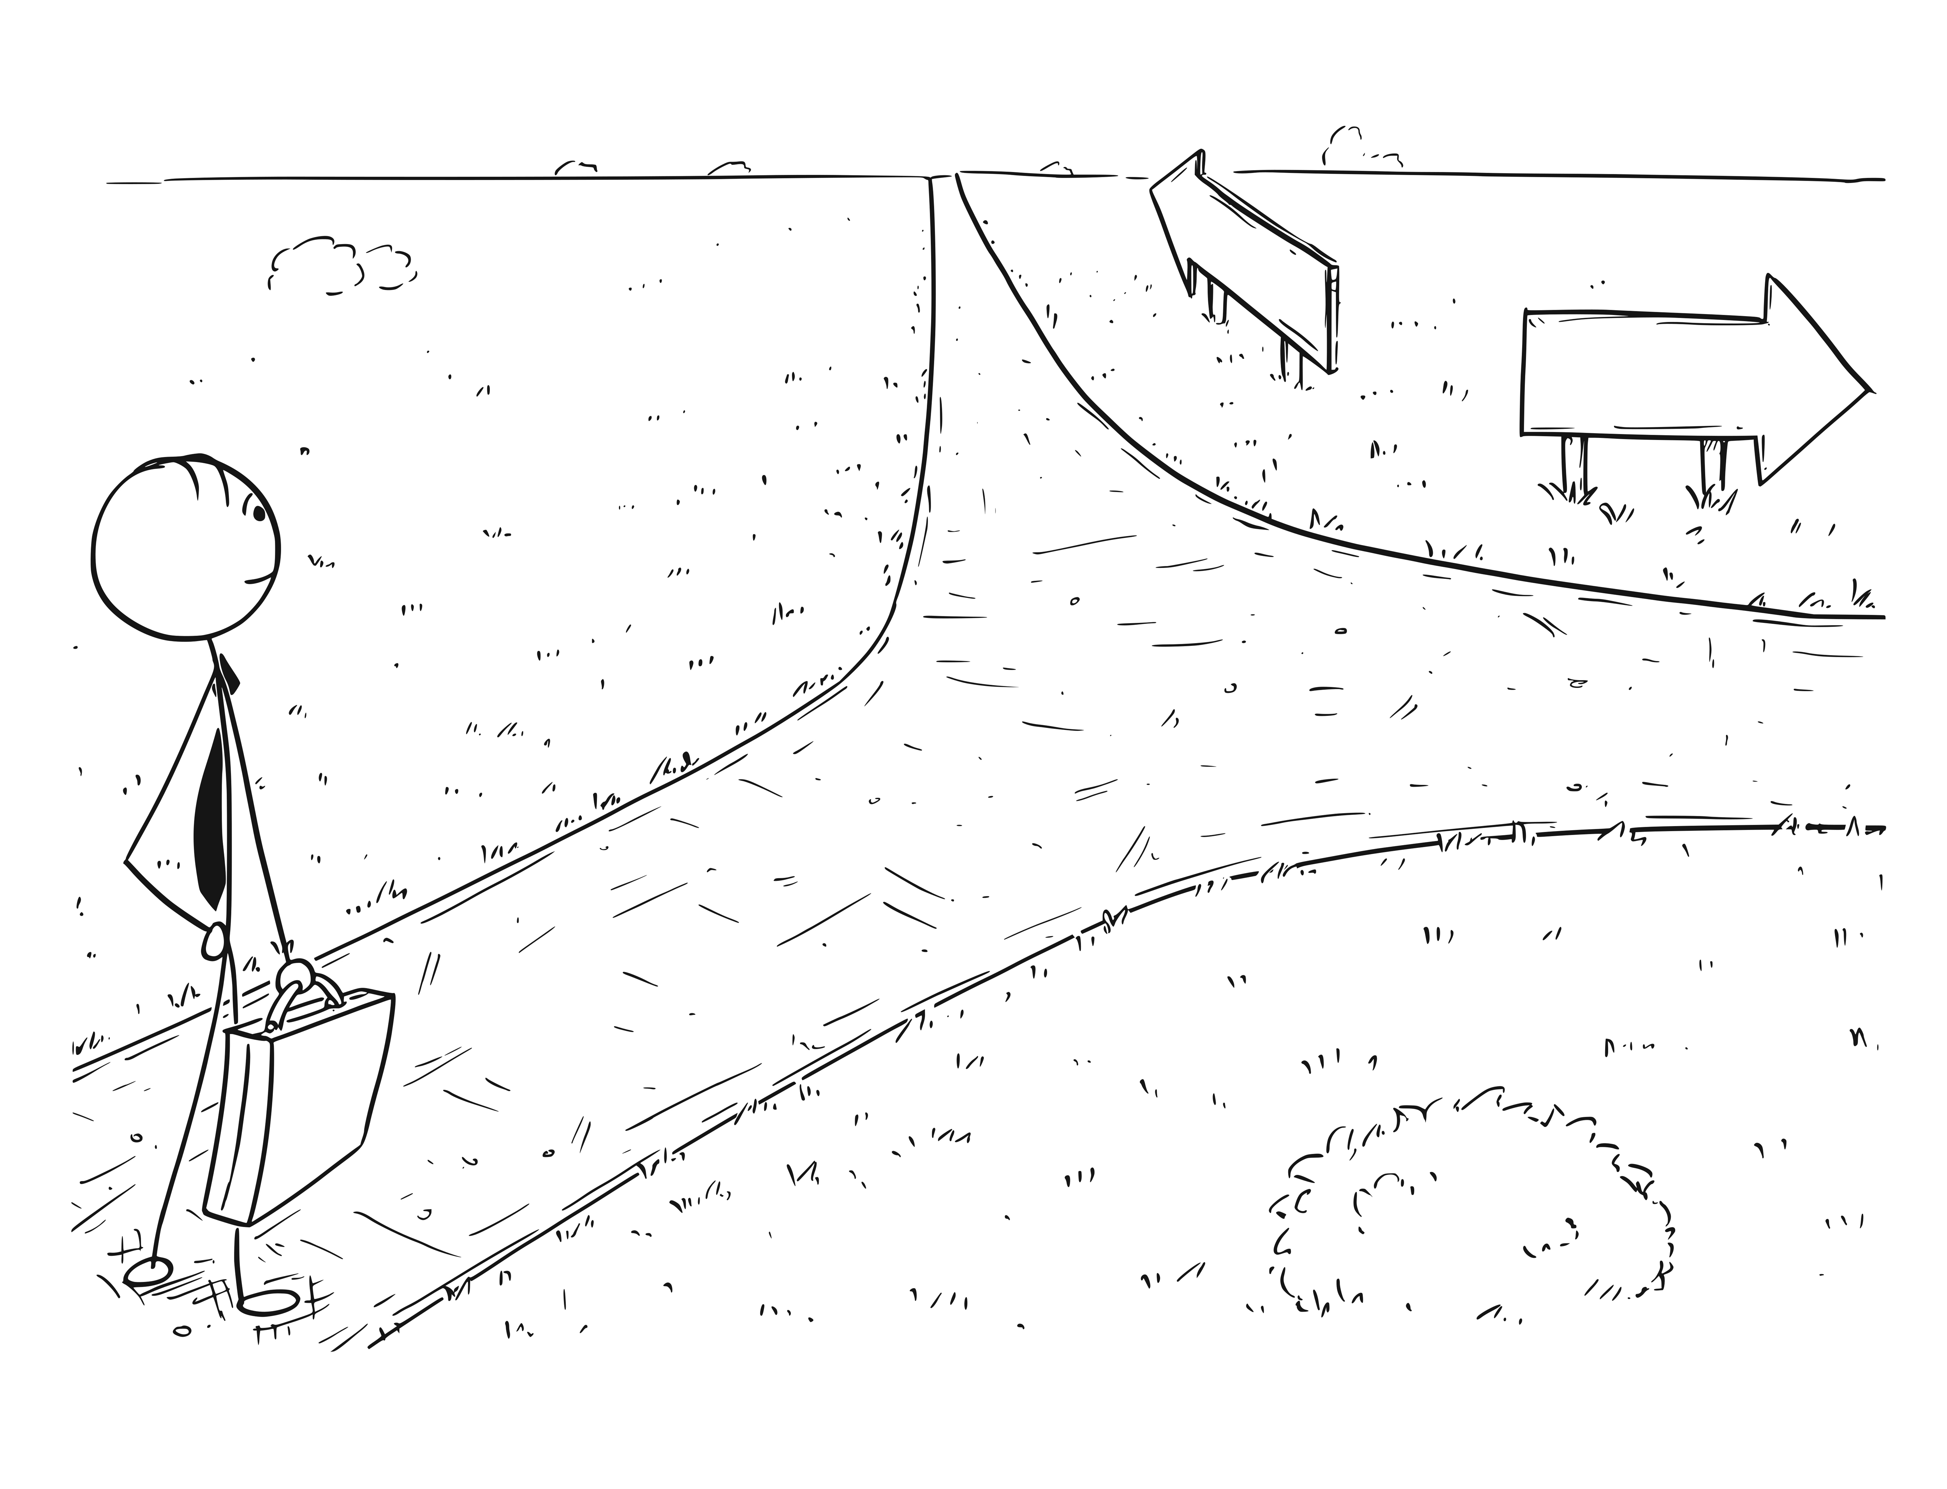
Notes:
I had a decision to make, so in 2018, I left my team. It was one of the hardest decisions I’ve ever had to make.

Slide 40
2000
Tech Lead / Project Director
2007
Consultant /
Tech Lead
2016–2018
Team Leader
2018–2019
Director of Engineering
2019–2020
Back to being an IC
2020–2021
Principal Analyst leading offshore team
2022-current
Current - Principal Consultant with direct reports
1995-2000
Just a developer
2021
Principal -> Dev Manager
2014-2015
Senior Developer

Slide 41
2000
Tech Lead / Project Director
2007
Consultant /
Tech Lead
2016–2018
Team Leader
2018–2019
Director of Engineering
2019–2020
Back to being an IC
2020–2021
Principal Analyst leading offshore team
2022-current
Current - Principal Consultant with direct reports
1995-2000
Just a developer
2021
Principal -> Dev Manager
2014-2015
Senior Developer

Slide 42
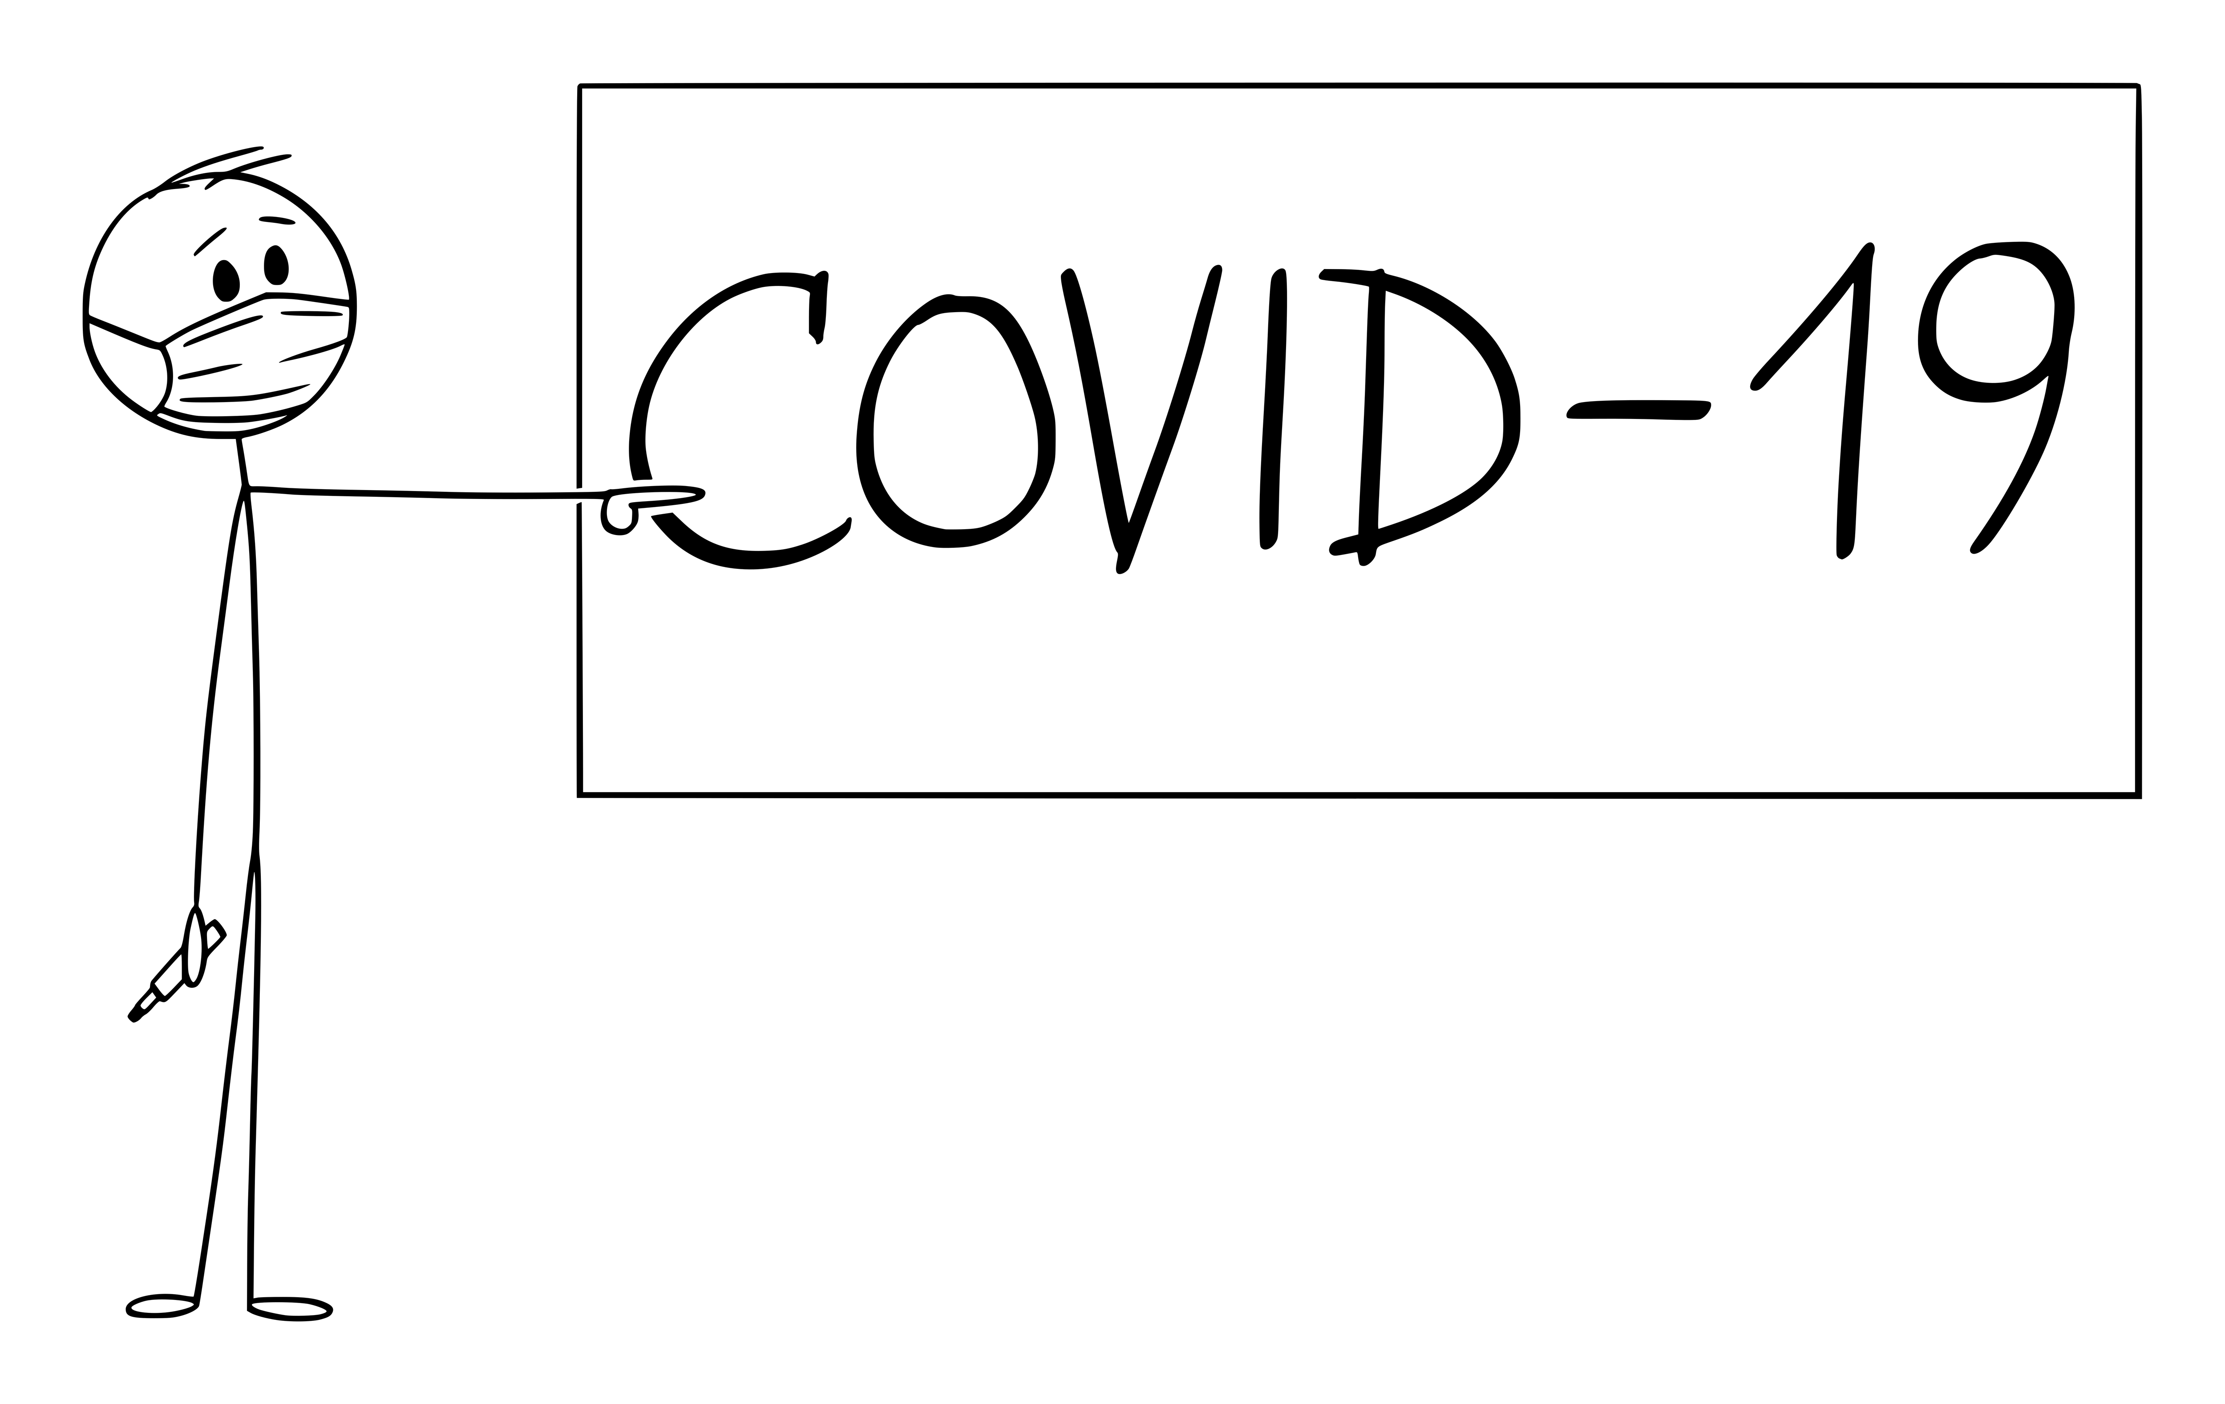

Slide 43
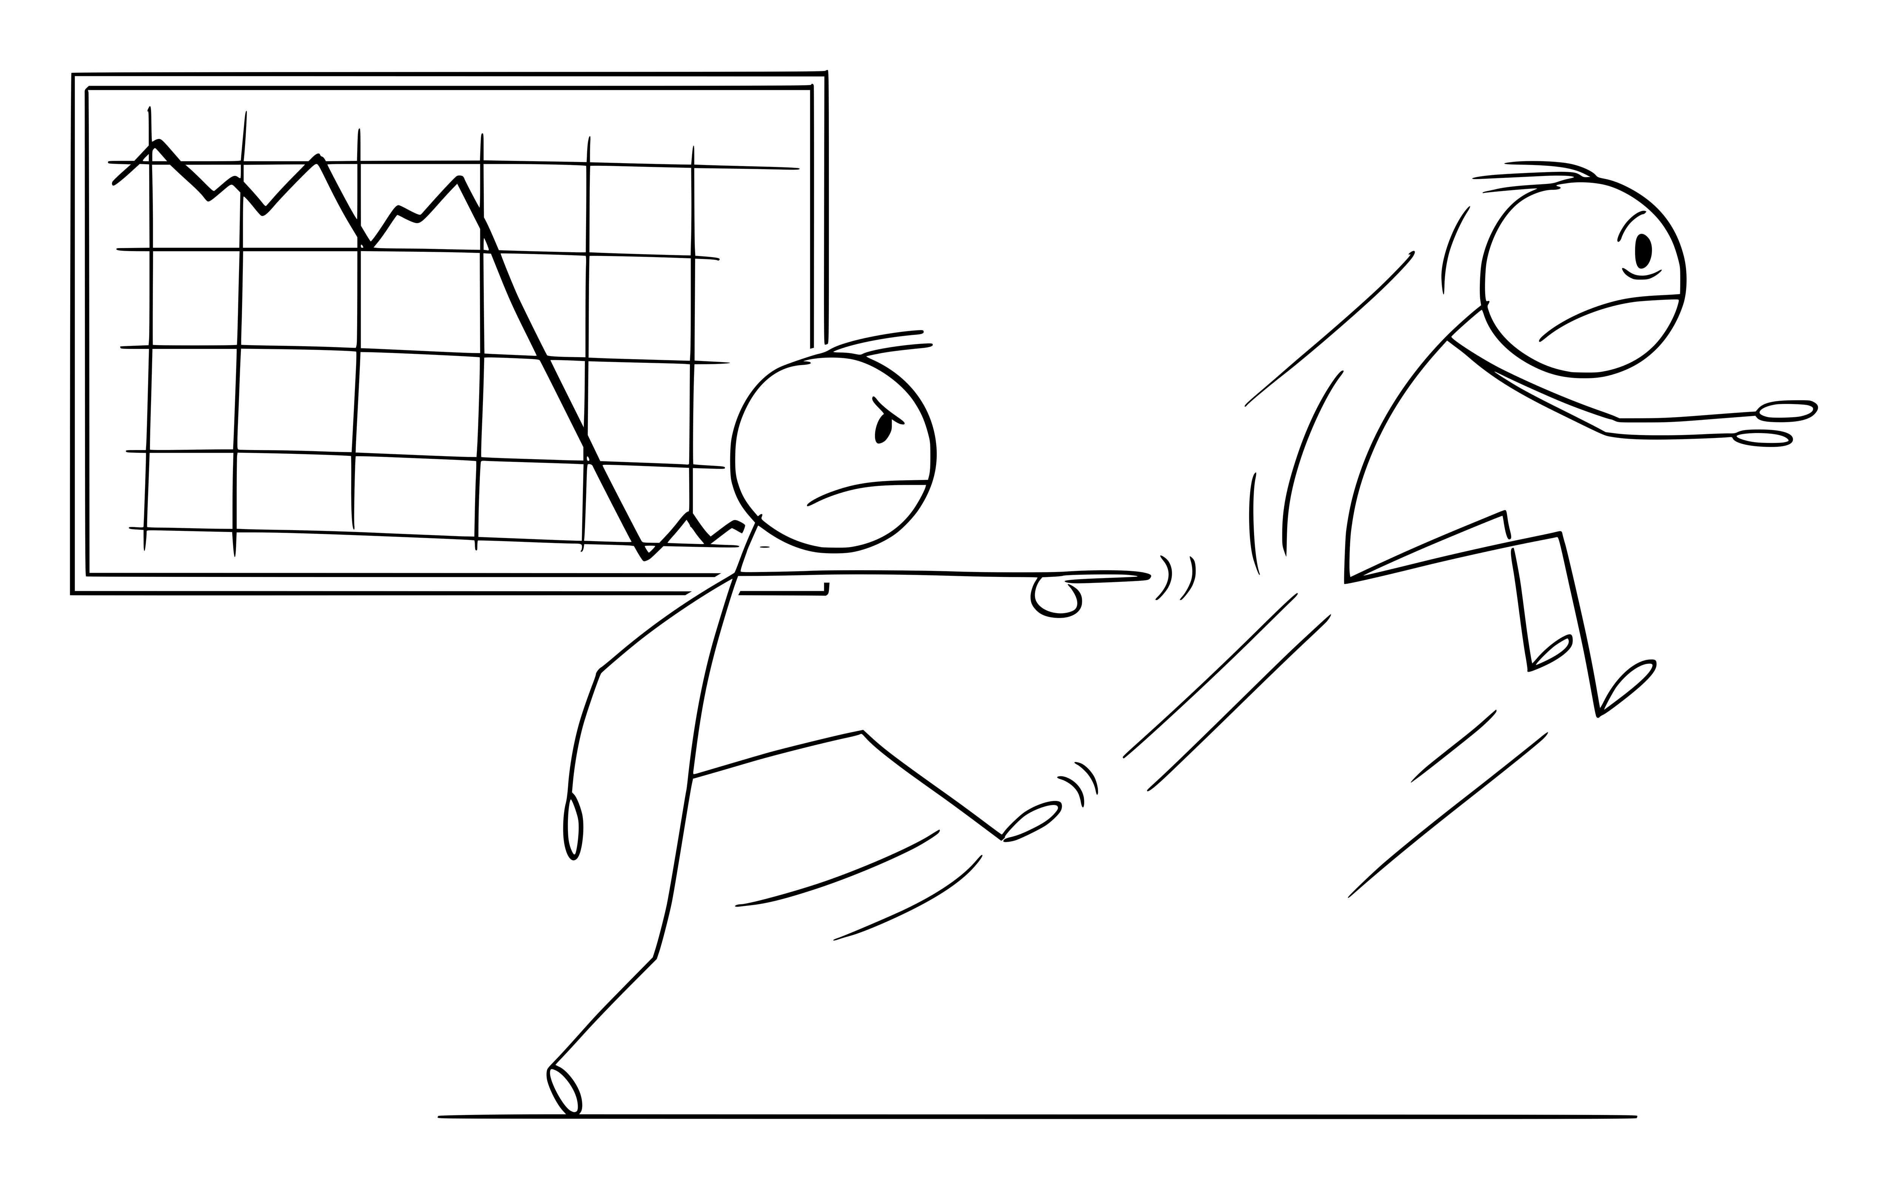
Notes:
And then 40 of my closest coworkers and I were furloughed with promises to bring us all back in a few months.
Spoiler alert: they only brought back 5…in August.
But that’s ok, because on the first day of my furlough, I reached out on social media…

Slide 44

Notes:
And opportunity knocked.

Slide 45
2000
Tech Lead / Project Director
2007
Consultant /
Tech Lead
2016–2018
Team Leader
2018–2019
Director of Engineering
2019–2020
Back to being an IC
2020–2021
Principal Analyst leading offshore team
2022-current
Current - Principal Consultant with direct reports
1995-2000
Just a developer
2021
Principal -> Dev Manager
2014-2015
Senior Developer

Slide 46
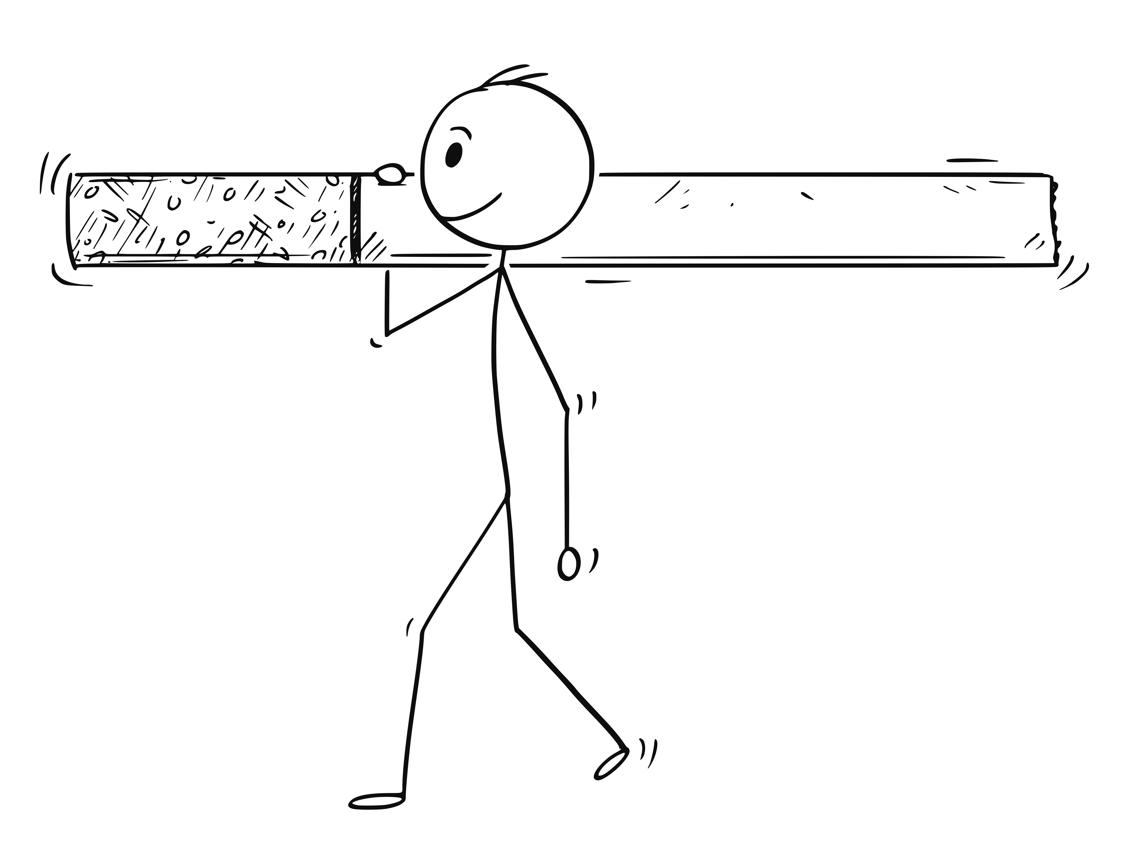
Notes:
I spent 18 months working for Big Tobacco, leading an offshore team. We built all sorts of cool APIs and integrations with Salesforce.
BUT, I wasn’t supposed to be coding. I still did because I’m a developer at heart.
There came a point though where working for Big Tobacco was dragging on me a bit. I’m not a smoker and never have been. I’m not judging anyone who is, but it’s a surreal experience to be on calls figuring out how to sell more of a product that I don’t use and can’t really relate to.
I was also bored, so…on I went, but back to an individual contributor role

Slide 47
2000
Tech Lead / Project Director
2007
Consultant /
Tech Lead
2016–2018
Team Leader
2018–2019
Director of Engineering
2019–2020
Back to being an IC
2020–2021
Principal Analyst leading offshore team
2022-current
Current - Principal Consultant with direct reports
1995-2000
Just a developer
2021
Principal -> Dev Manager
2014-2015
Senior Developer
Notes:
This was an interesting job. I went there because a close friend said I could really help them.
I started out as a Principal Developer, but within a couple months, when I had my first 1:1 with the CTO, he asked if I’d be interested in becoming a dev manager.
I was pulled back in.
The only problem was, I didn’t fit well at this place. I tried, but I struggled. There are times you’d like something to work, but quickly realize it’s not going to.
I may have vented on FB a bit…
A friend reached out…

Slide 48
2000
Tech Lead / Project Director
2007
Consultant /
Tech Lead
2016–2018
Team Leader
2018–2019
Director of Engineering
2019–2020
Back to being an IC
2020–2021
Principal Analyst leading offshore team
2022-current
Current - Principal Consultant with direct reports
1995-2000
Just a developer
2021
Principal -> Dev Manager
2014-2015
Senior Developer
Notes:
I wasn’t officially looking for a new job even though I was struggling to fit in where I was. There was a lot of churn and frequent fires to put out…I liked my team and was focused on helping them all become better.
My friend reached out and asked me to come to a summer gathering Improving was having…no obligation - come, drink free beer, and talk.

Slide 49
Developer
Leader

Slide 50
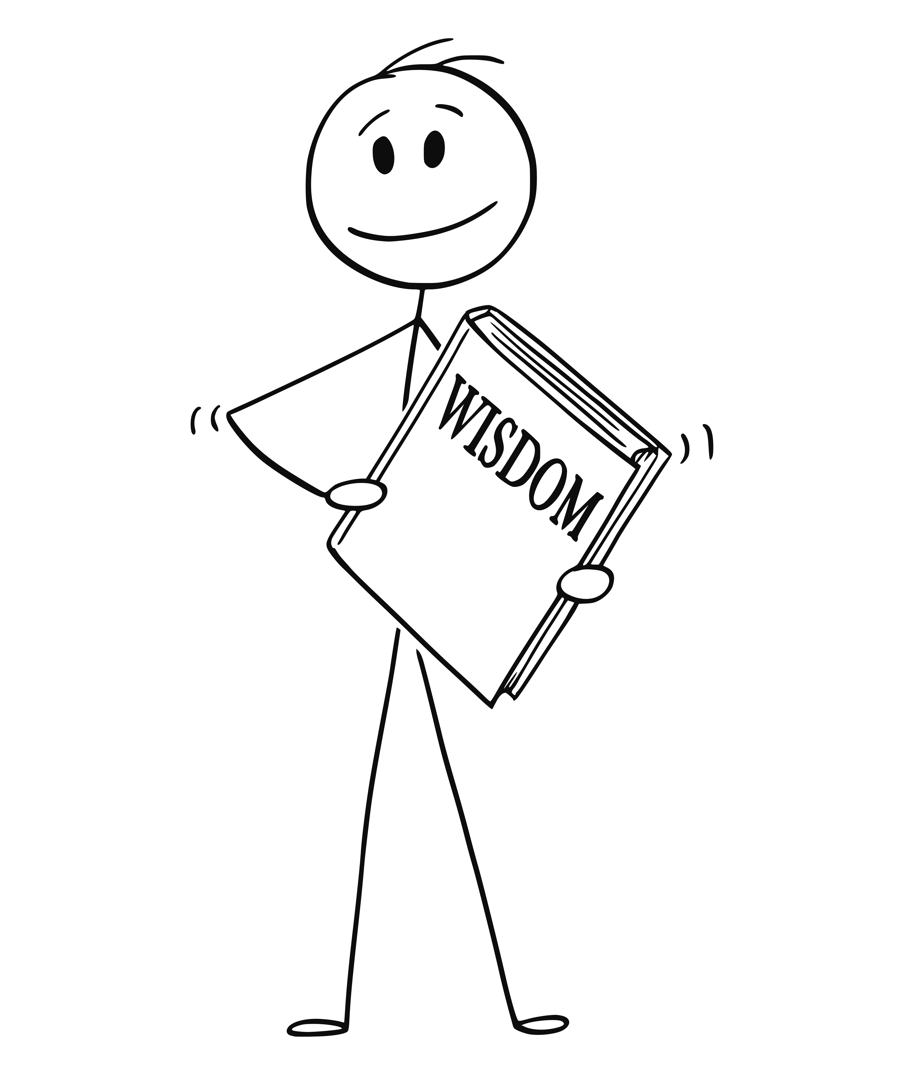
Title doesn’t make you a leader. Actions make you a leader.
Know your why
Work on your EQ
Lose your ego
Find a mentor
Leading friends can be tough. Be tough
Complain up or sideways, never down
Take the bad with the good
Seek feedback
Take the feedback for what it is…
Know when enough is enough
Be consistent
Own your mistakes

Slide 51
Leadership Journey, Jim Holmes
Extreme Ownership, Jocko Wilink / Leif Babin
Emotional Intelligence 2.0, Travis Bradberry / Jean Greaves
Leadership in the Shadows, Kyle Lamb
Will It Make the Boat Go Faster?, Ben Hunt-Davis
Red Circle, Brandon Webb
How to Win Friends and Influence People, Dale Carnegie
Ego is the Enemy, Ryan Holiday
Strengths Based Leadership, Tom Path

Slide 52
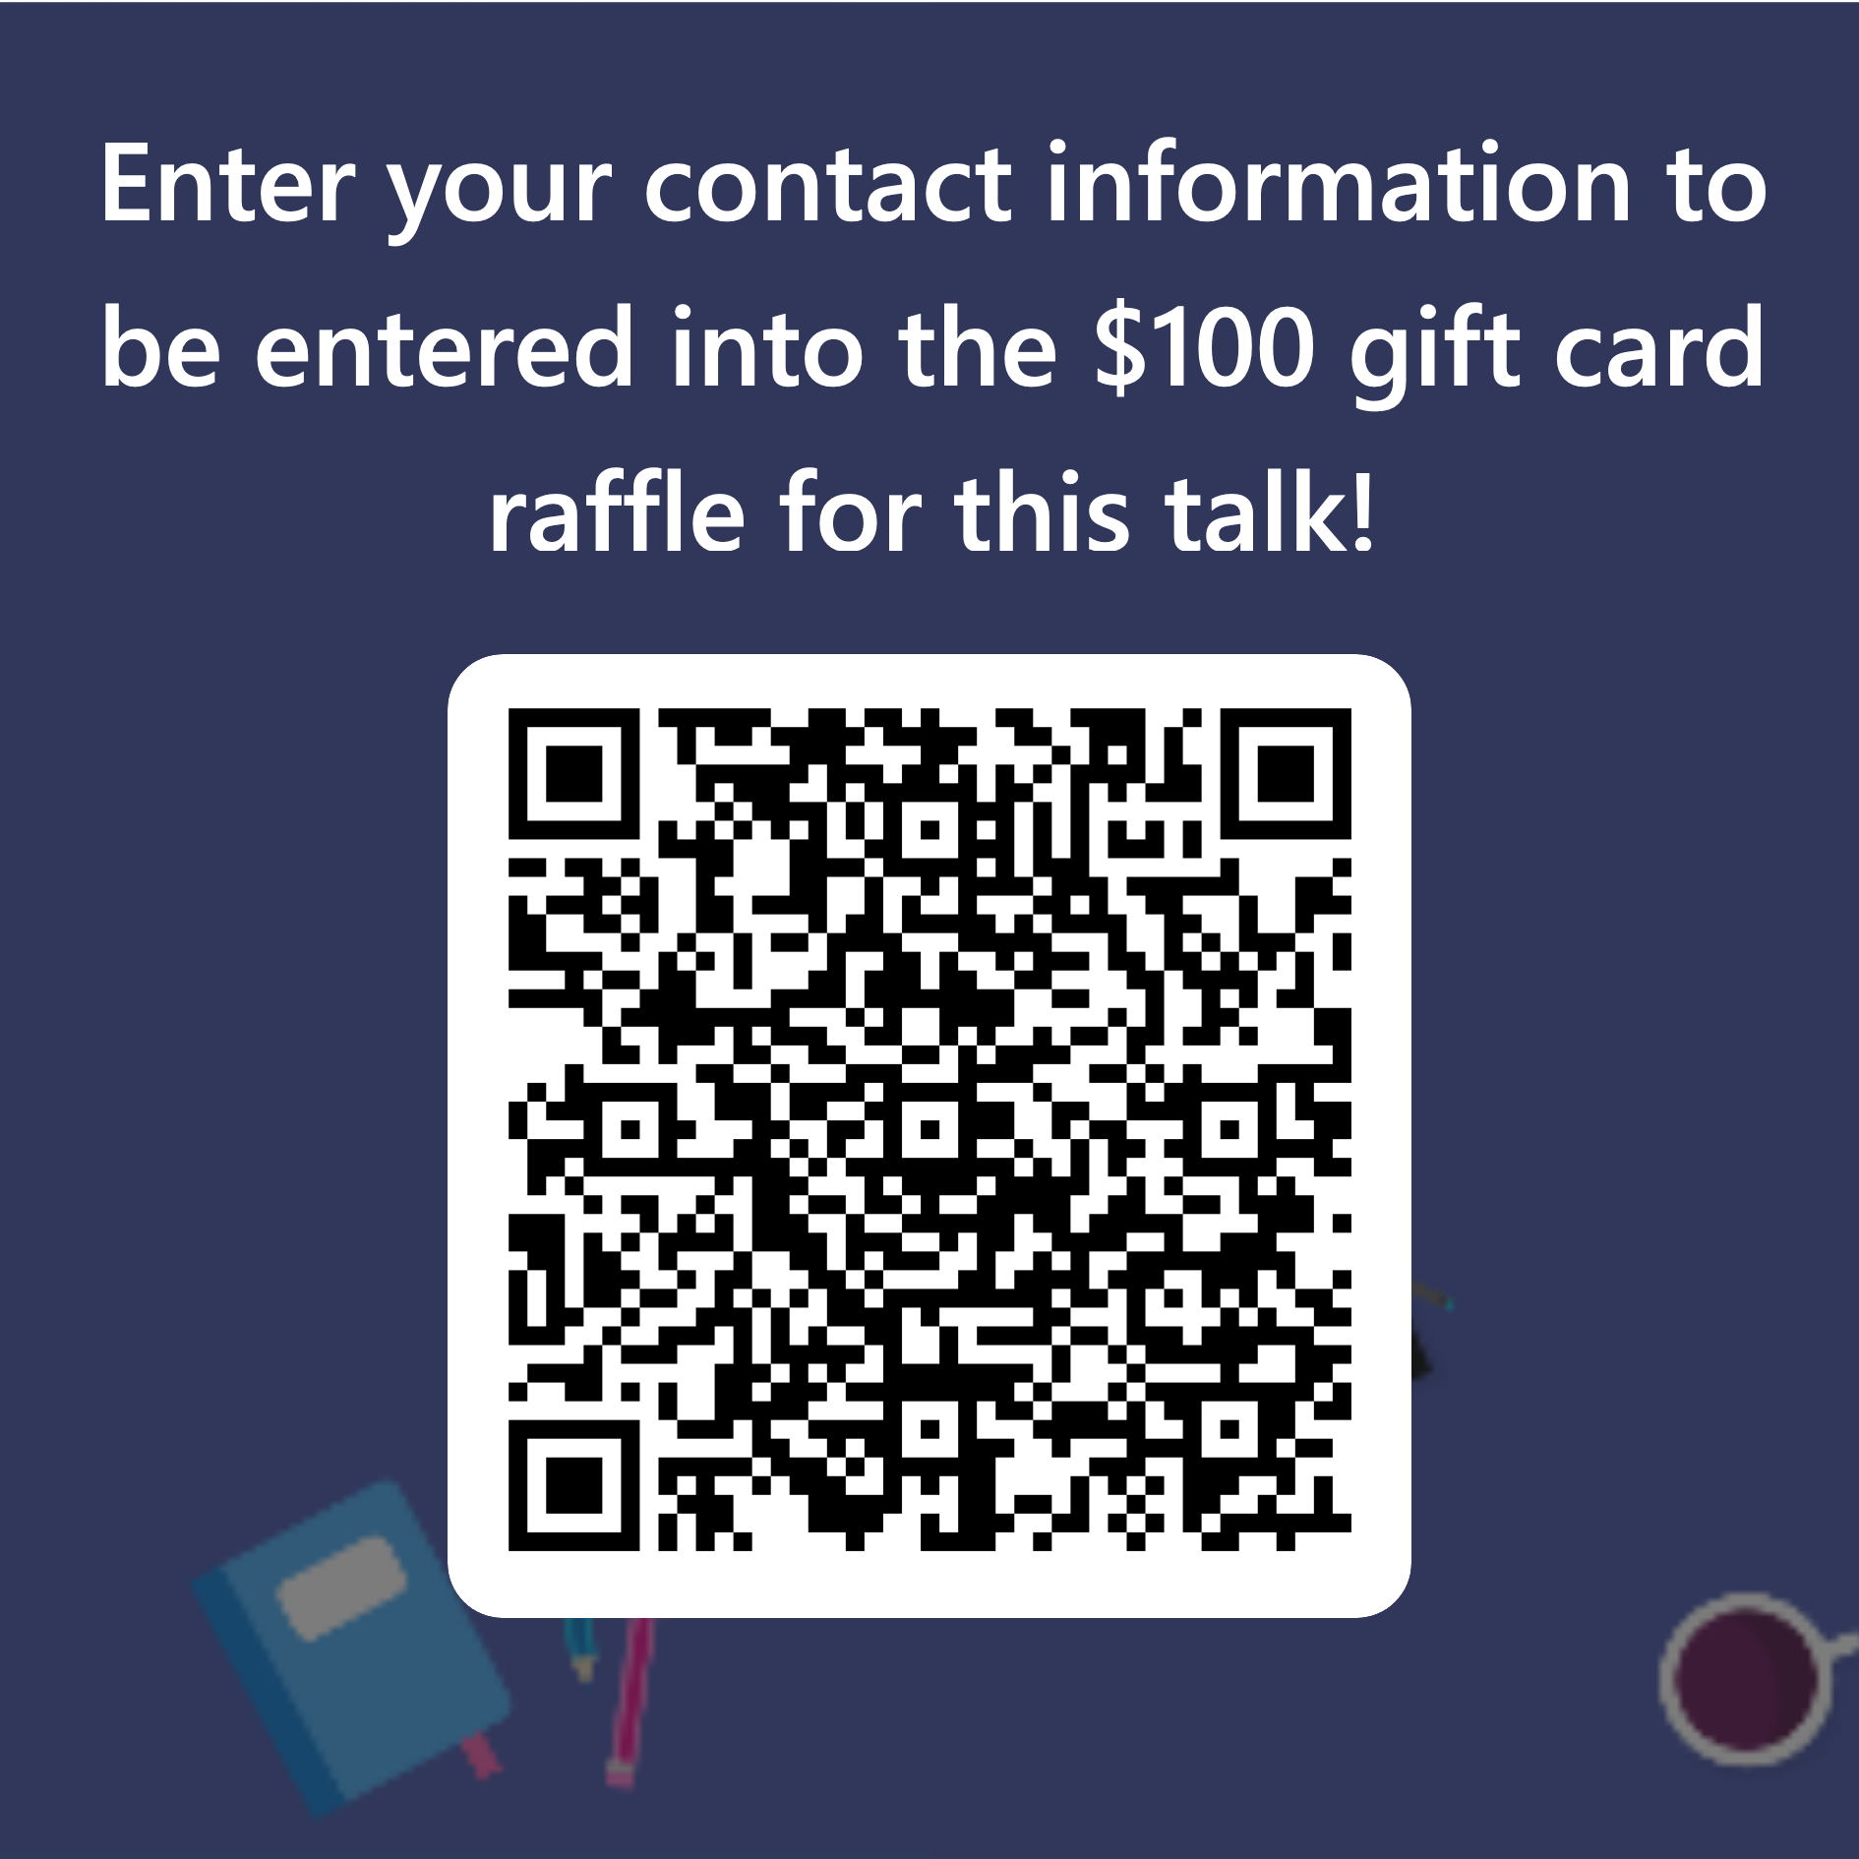

Slide 53
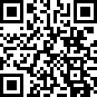
Mjeaton everywhere – shortcut: https://samestuffdifferentday.net/about
Work email: michael.eaton@improving.com
Personal email: mjeaton@gmail.com

